Slide 1
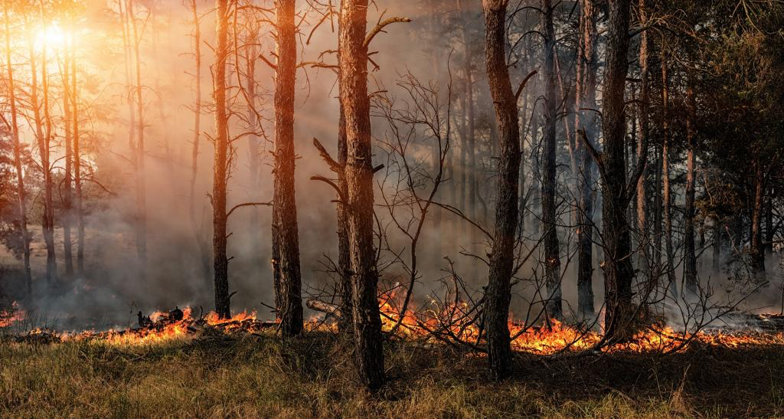

Study of wildfires in the us For the years 1992-2015

Slide 2
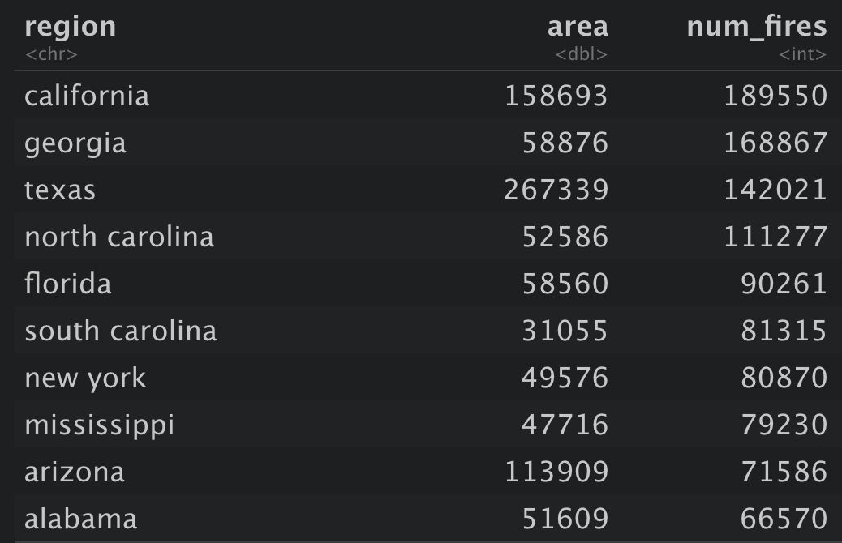
1) Which States have the highest likelihood of a wildfire occurring
Top 3 States with the most total number of fires are:
California
Georgia
Texas
However Georgia is only an average sized state but has a lot of fire
Therefore we shall normalise state size, but calculating number of fires per square mile.

Slide 3
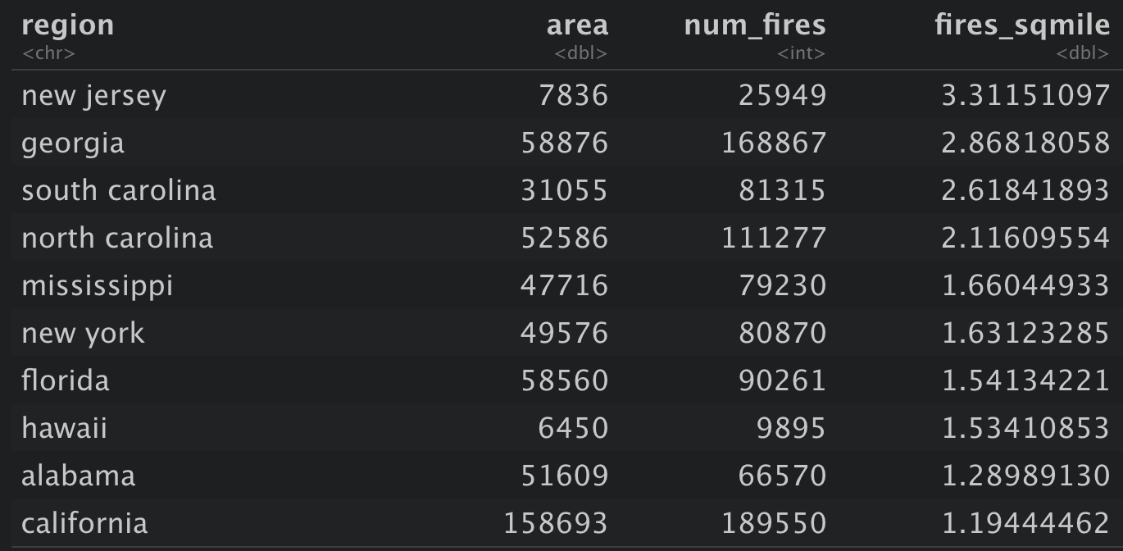
1) Which States have the highest likelihood of a wildfire occurring
Now considering the number of fires per square mile the top 3 are:
New Jersey
Georgia
South Carolina
Texas is not in the top 10 at all and California is only just.
This is a better way of seeing which States have a larger probability of a wildfire.

Slide 4
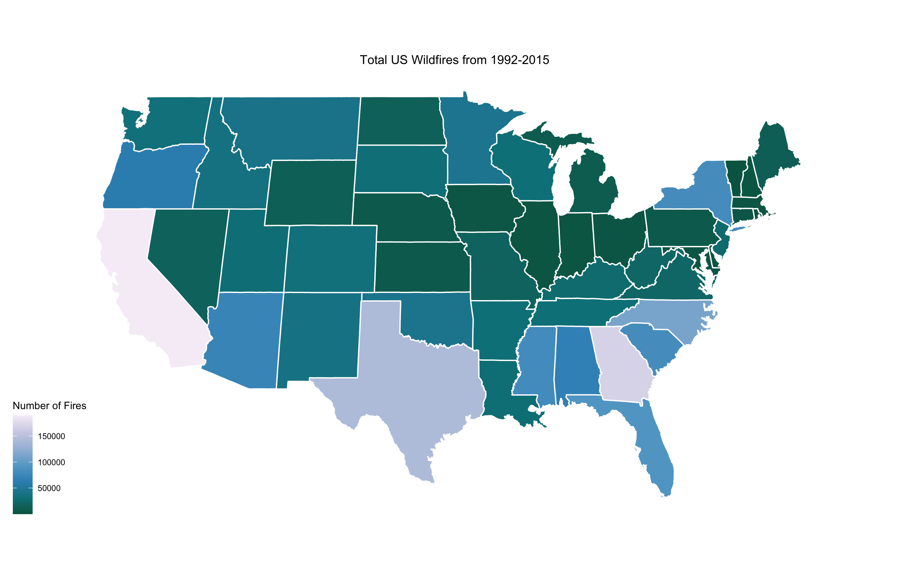
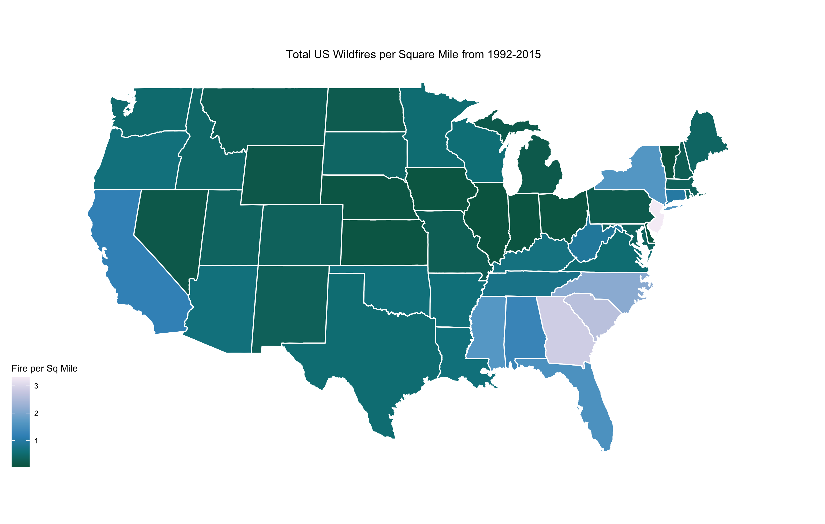
1) Which States have the highest likelihood of a wildfire occurring

Slide 5
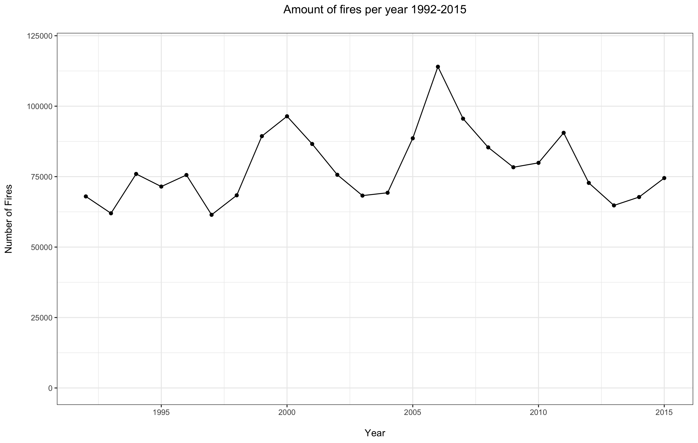
2) Have occurrences of wildfires increased or decreased over the reporting period
From the total number of fires per year, it can be seen that there is a pattern of peaks.
These seem to coincide with recorded heatwaves in North America, although this is not definite proof of the reason for the peaks. ⁽¹⁾
Visually looking at the plot there doesn’t seem to be any overall trend of increase or decrease in the number of fires, but I modelled the data to prove mathematically.
¹⁾ https://en.wikipedia.org/wiki/List_of_heat_waves

Slide 6
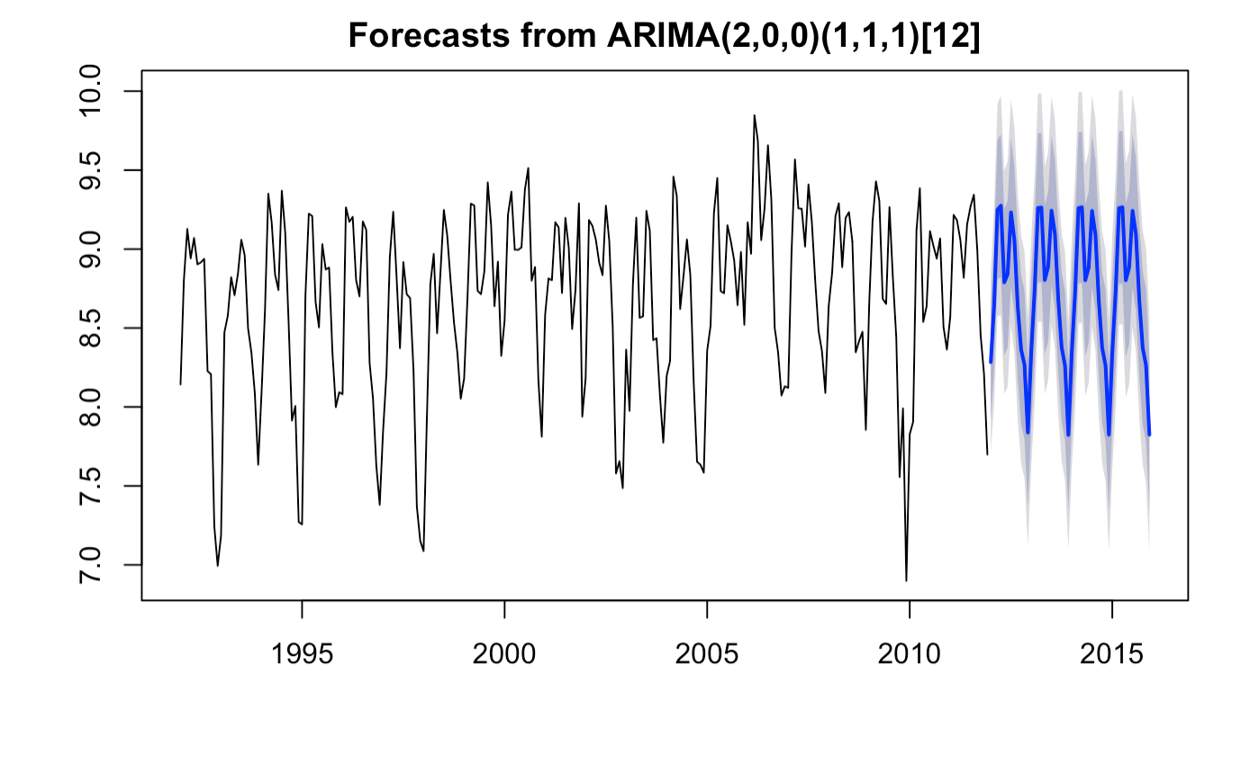
2) Have occurrences of wildfires increased or decreased over the reporting period
In order to get a more accurate picture of any trends present I have plotted the number of fires per month, instead of year
This plot clearly shows a double peak each year, which I intend to investigate later
To validate how accurate the model is I kept the last 4 years separate to compare.
Blue line is the SARIMA model.

Slide 7
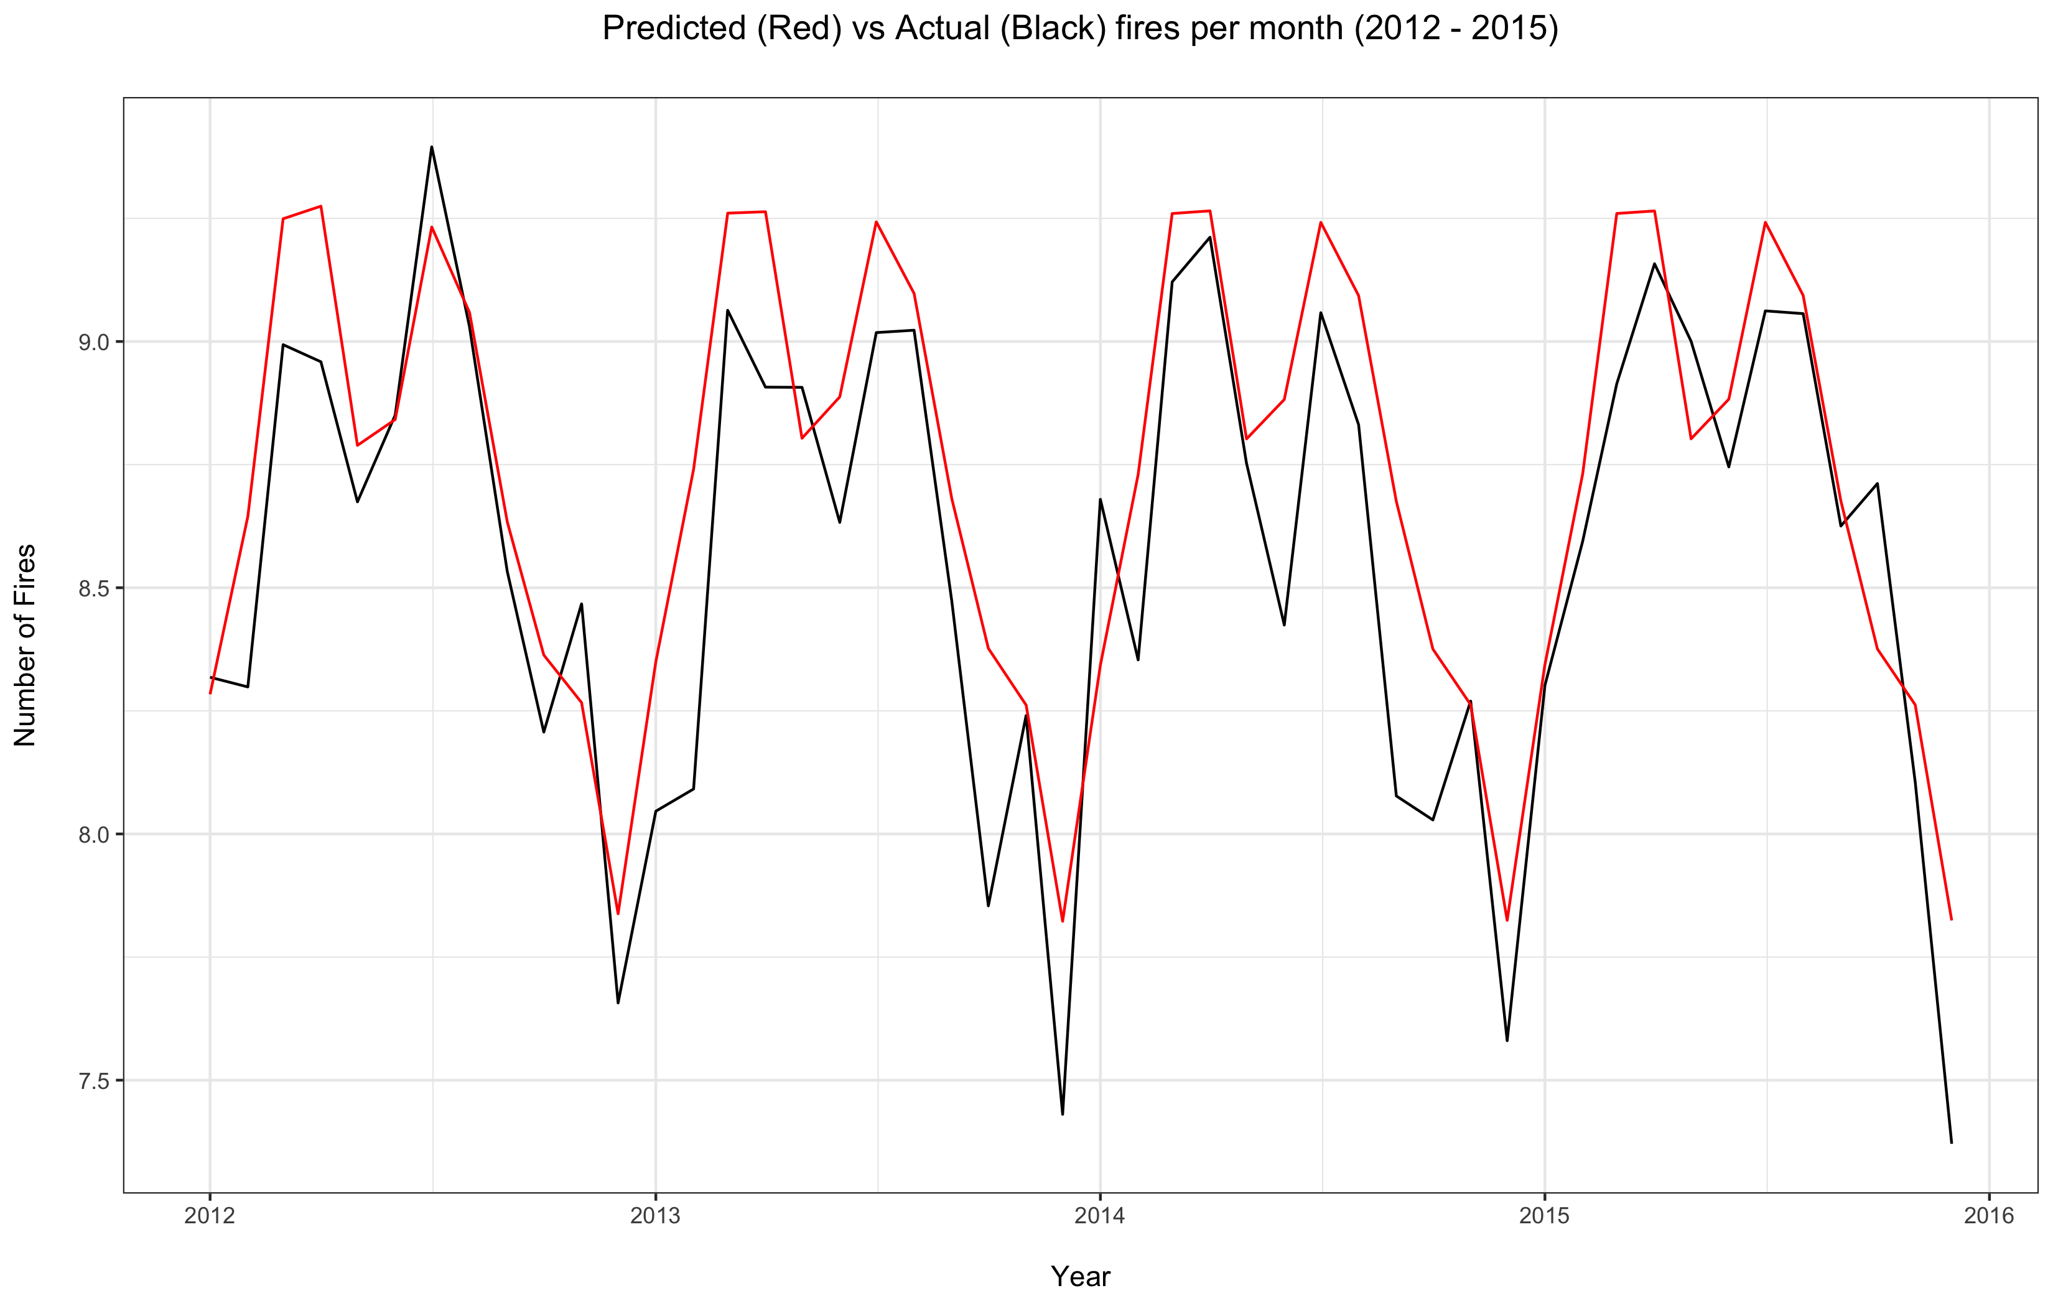
2) Have occurrences of wildfires increased or decreased over the reporting period
This plot shows the accuracy of the SARIMA model, with the predicted data in red versus the actual data in black
The model clearly has understood there is a double seasonal peak in wildfires each year
It was also shown that there has been no statistically significant increase or decrease in wildfires over the reporting period.

Slide 8
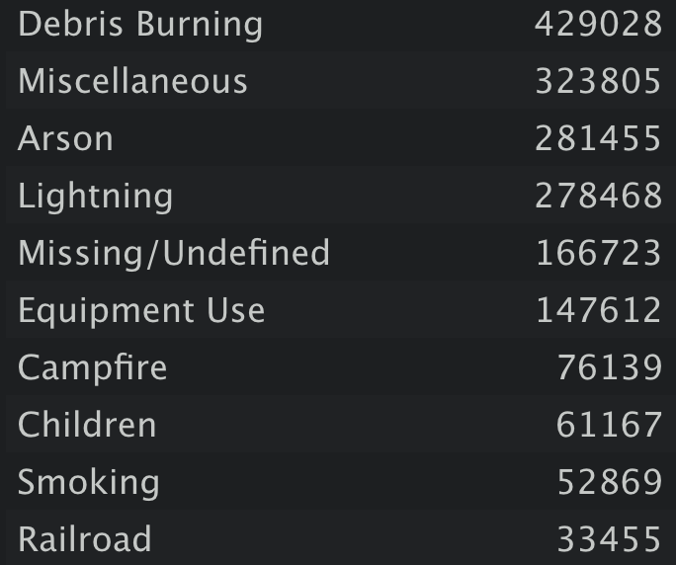

3) What are the main causes of wildfires occurring.
This list shows all the causes of fires record during the 1992-2015 period
Debris burning is the most common cause of fires by over 100,000.
Lightning is shown to be the highest natural cause of fires.

Slide 9
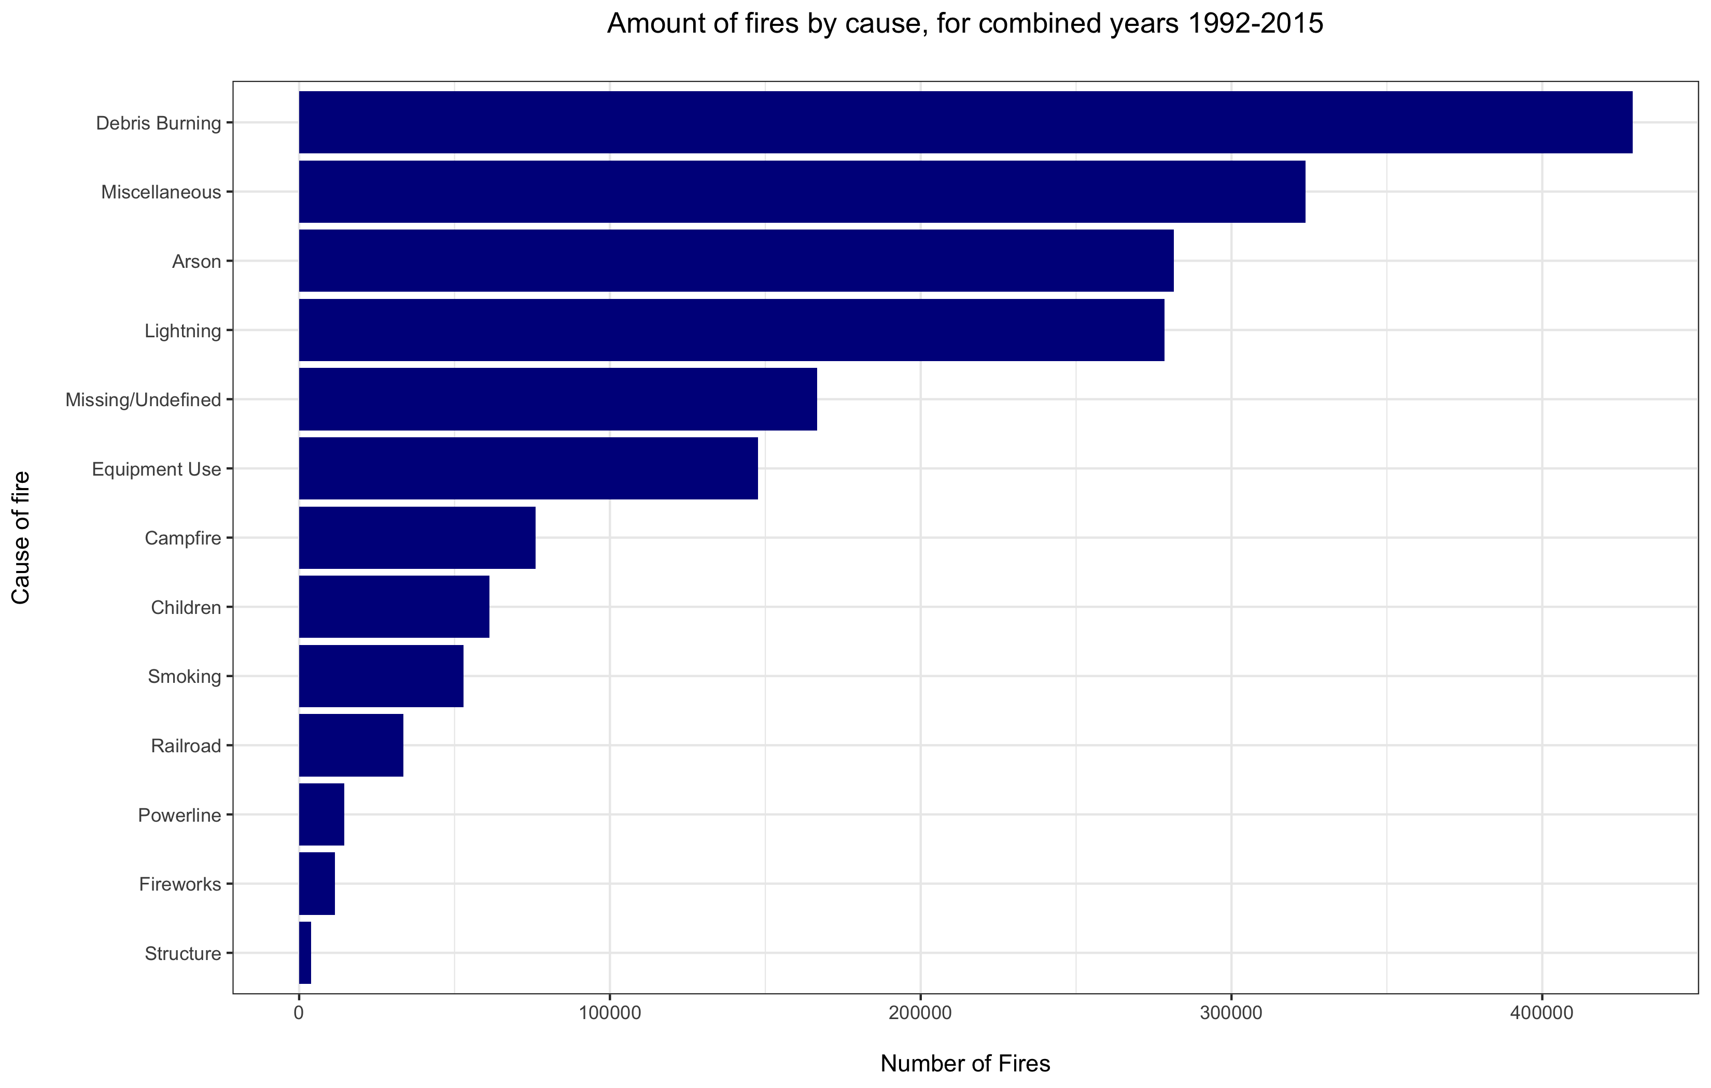
3) What are the main causes of wildfires occurring.

Slide 10
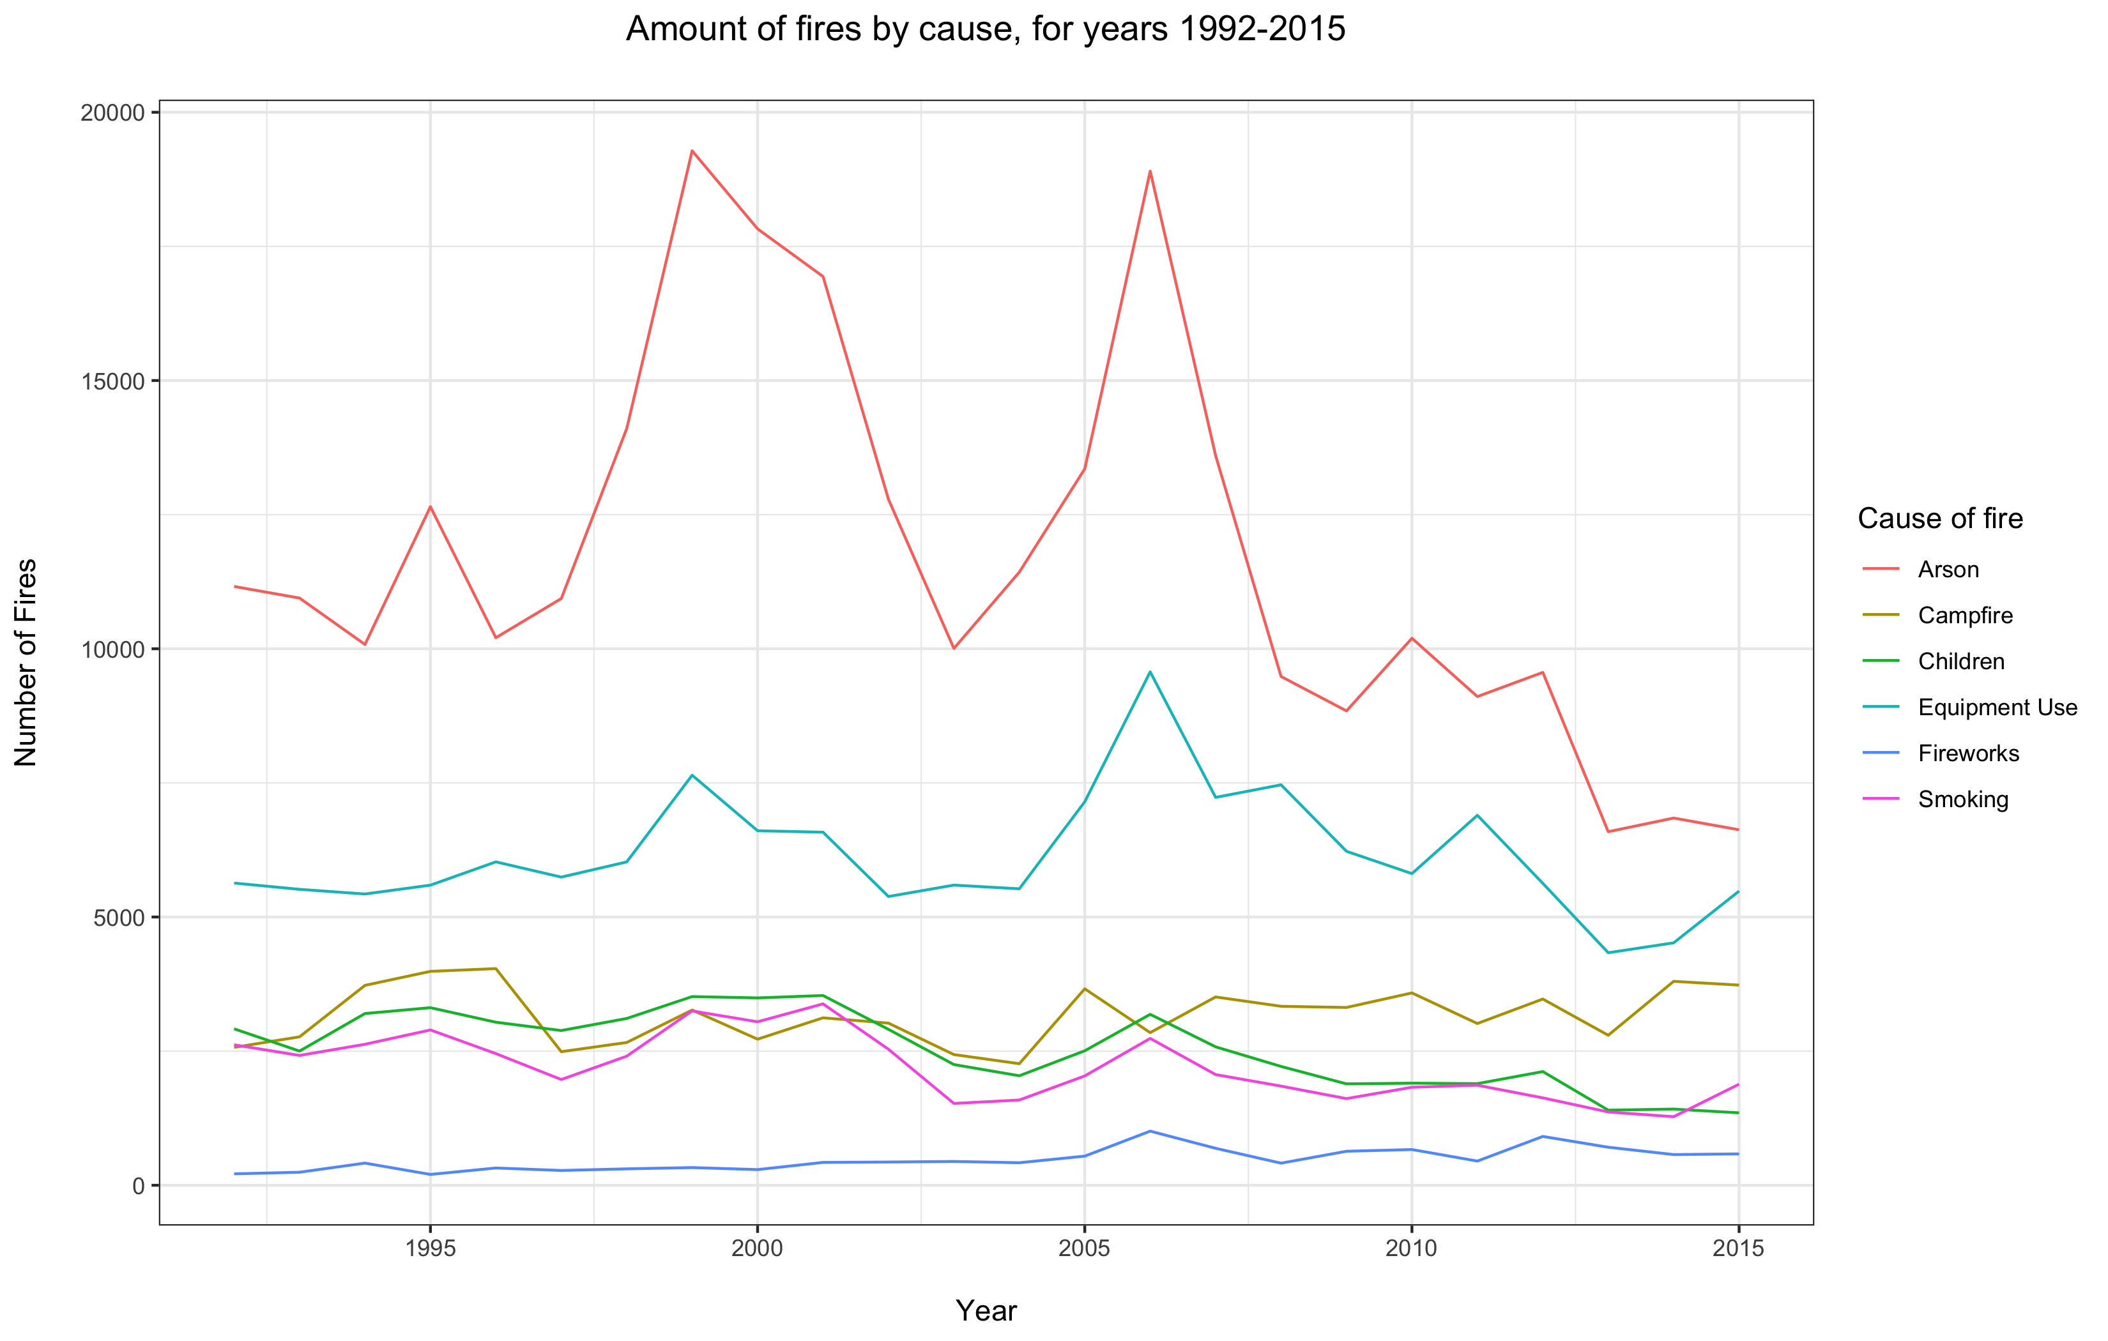
4) Have the causes of wildfires changed over the reporting period
For readability the causes have been split into 2 groups.
Arson is clearly the most common cause in group 1.
There are 2 big peaks in 1999 and 2006, both of these coincide with heatwaves in the US. ⁽¹⁾
Although there is no proof to link the heatwave to an increase of arson by itself, it is probable that the unusually warm conditions helped to dry the ground and increase the amount of fuel available for a fire to spread.
The 2006 peak is also seen in Equipment, Children, Smoking and Fireworks.
¹⁾ https://en.wikipedia.org/wiki/List_of_heat_waves

Slide 11
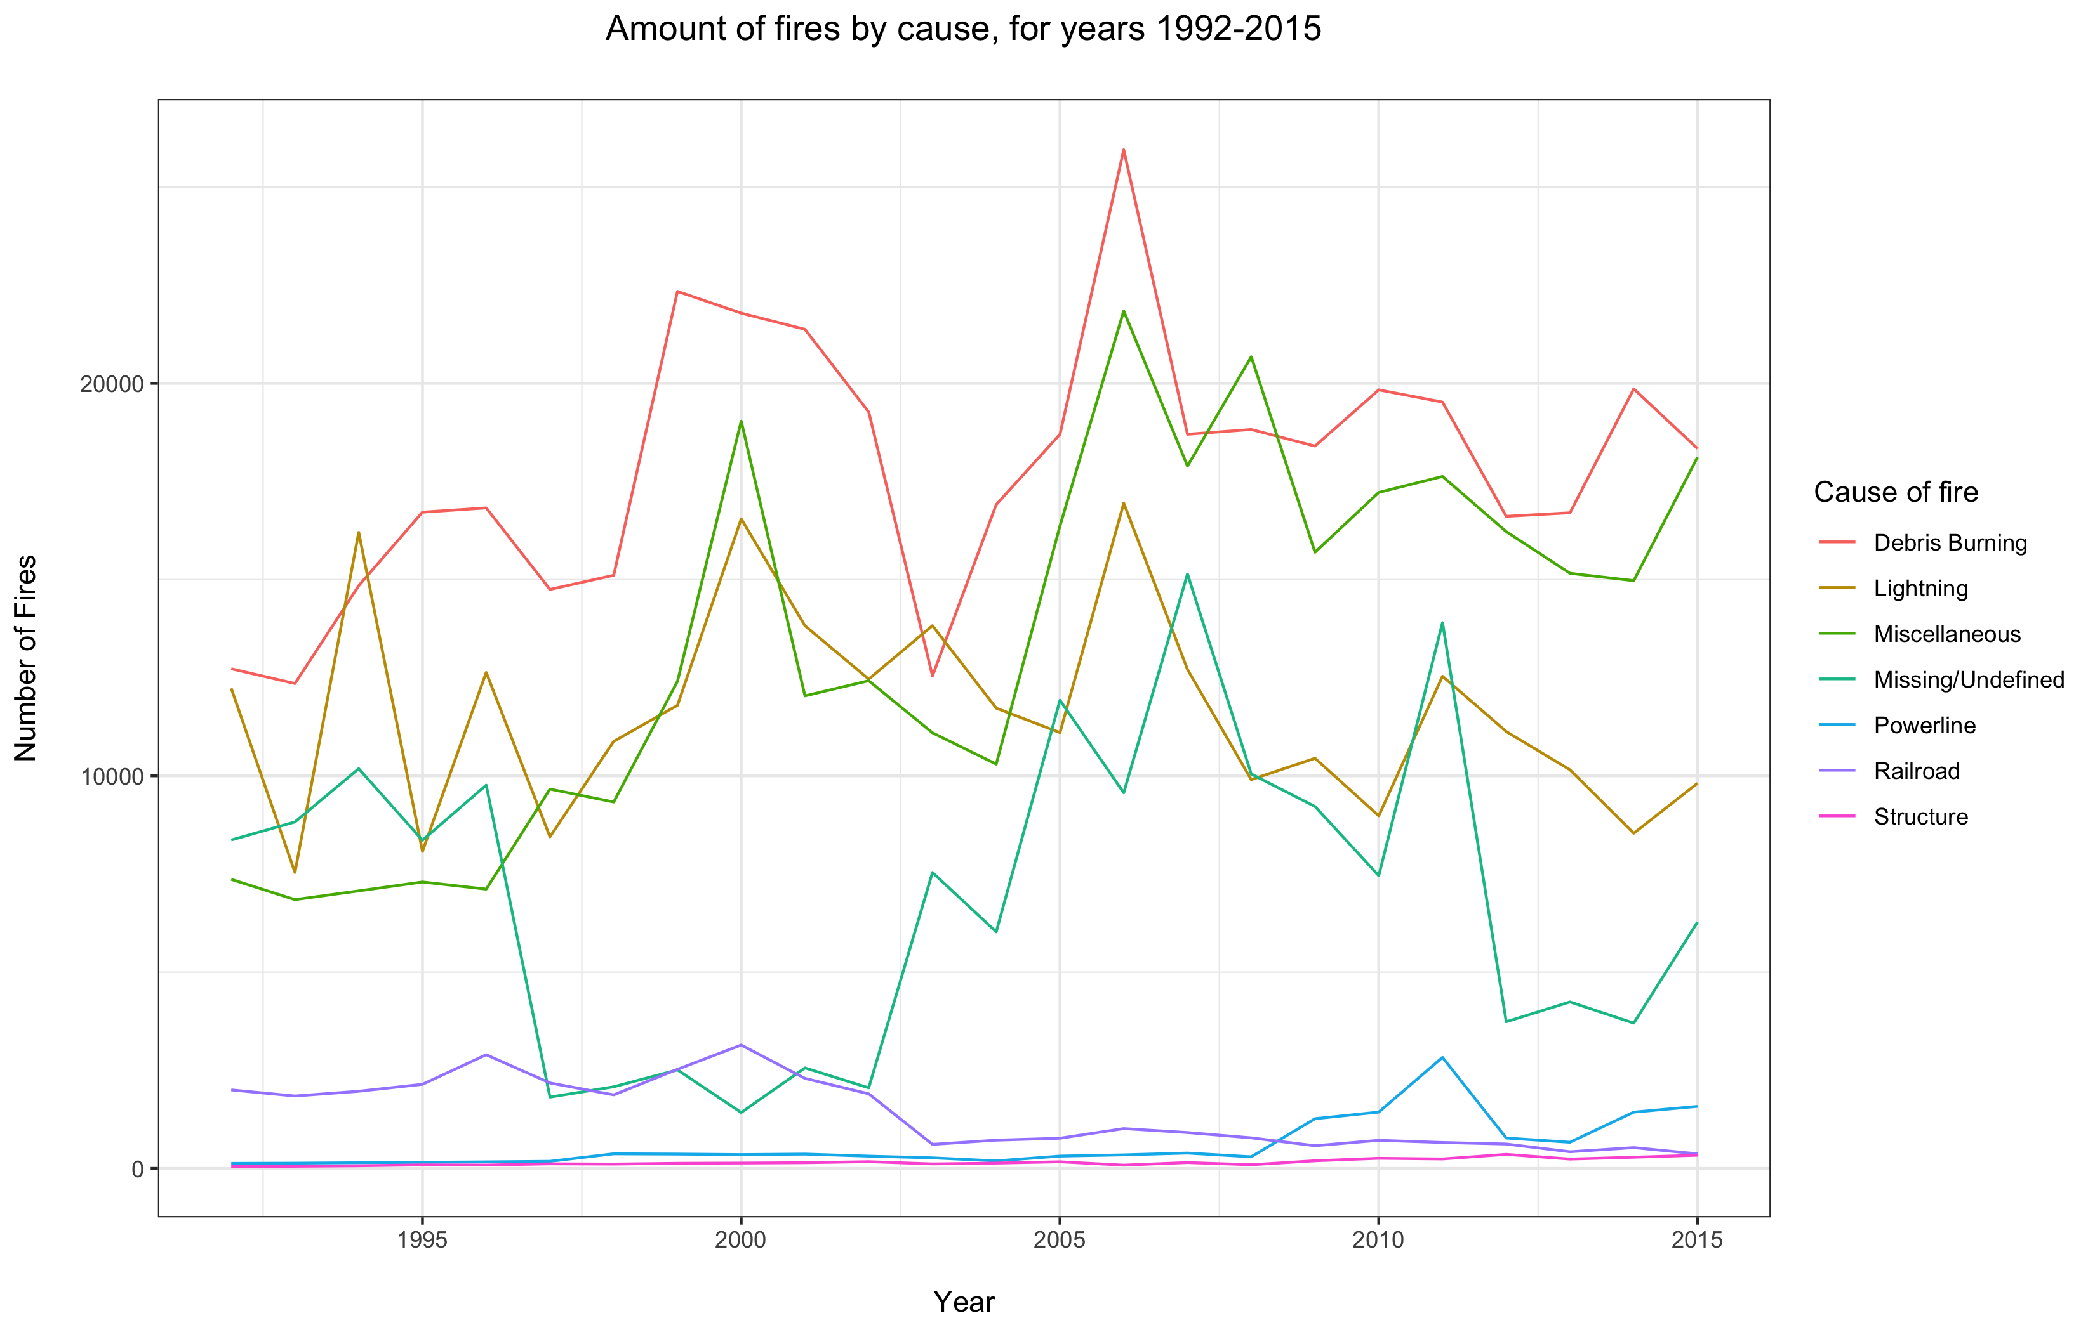
4) Have the causes of wildfires changed over the reporting period
Debris burning is the most common cause in group 1.
The peaks in 2000 and 2006 are visible in this plot are well. ⁽¹⁾
There is a defined trough in cases of Missing/Undefined data from 1997 – 2002, with a corresponding increase in Miscellaneous and Lightning.
¹⁾ https://en.wikipedia.org/wiki/List_of_heat_waves

Slide 12
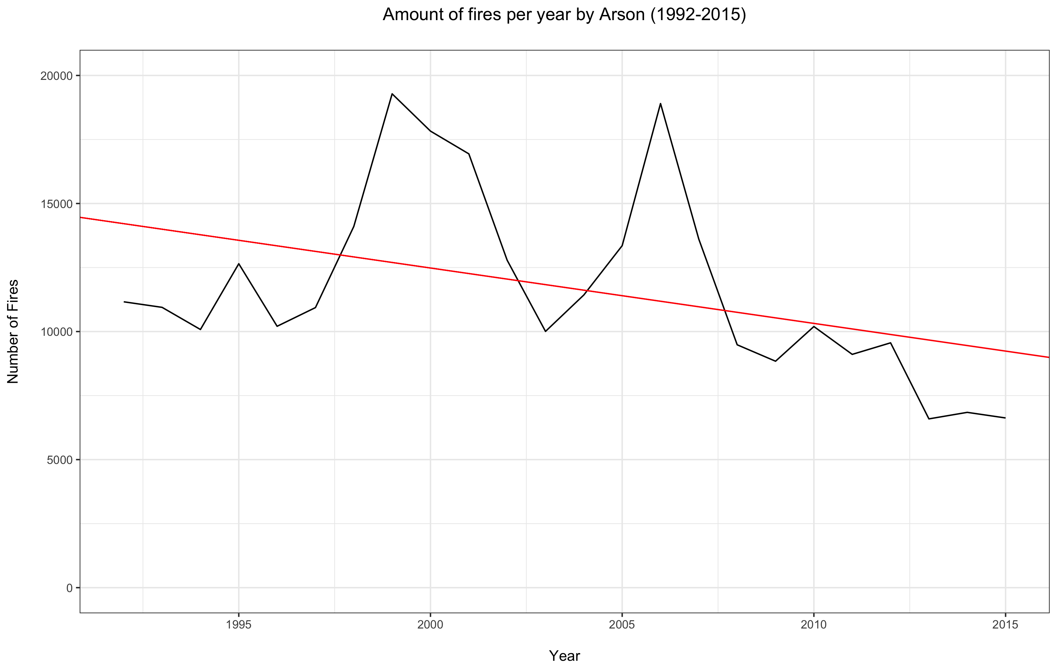
4) Have the causes of wildfires changed over the reporting period
A linear model was applied to the arson data and it has been shown that there has been statistically significant decrease of fires due arson over the reporting period.

Slide 13
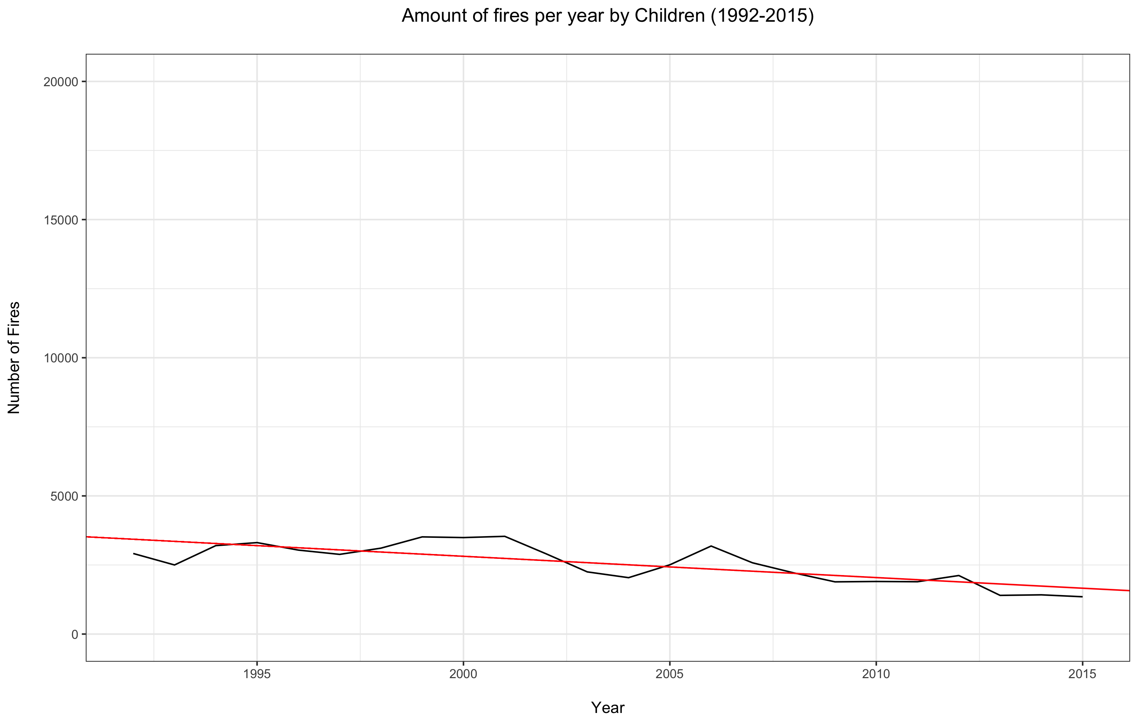
4) Have the causes of wildfires changed over the reporting period
A linear model was applied to the children cause data and it was also shown that there has been statistically significant decrease of fires due children over the reporting period.
Other causes were shown to have not changed significantly over the reporting period.

Slide 14
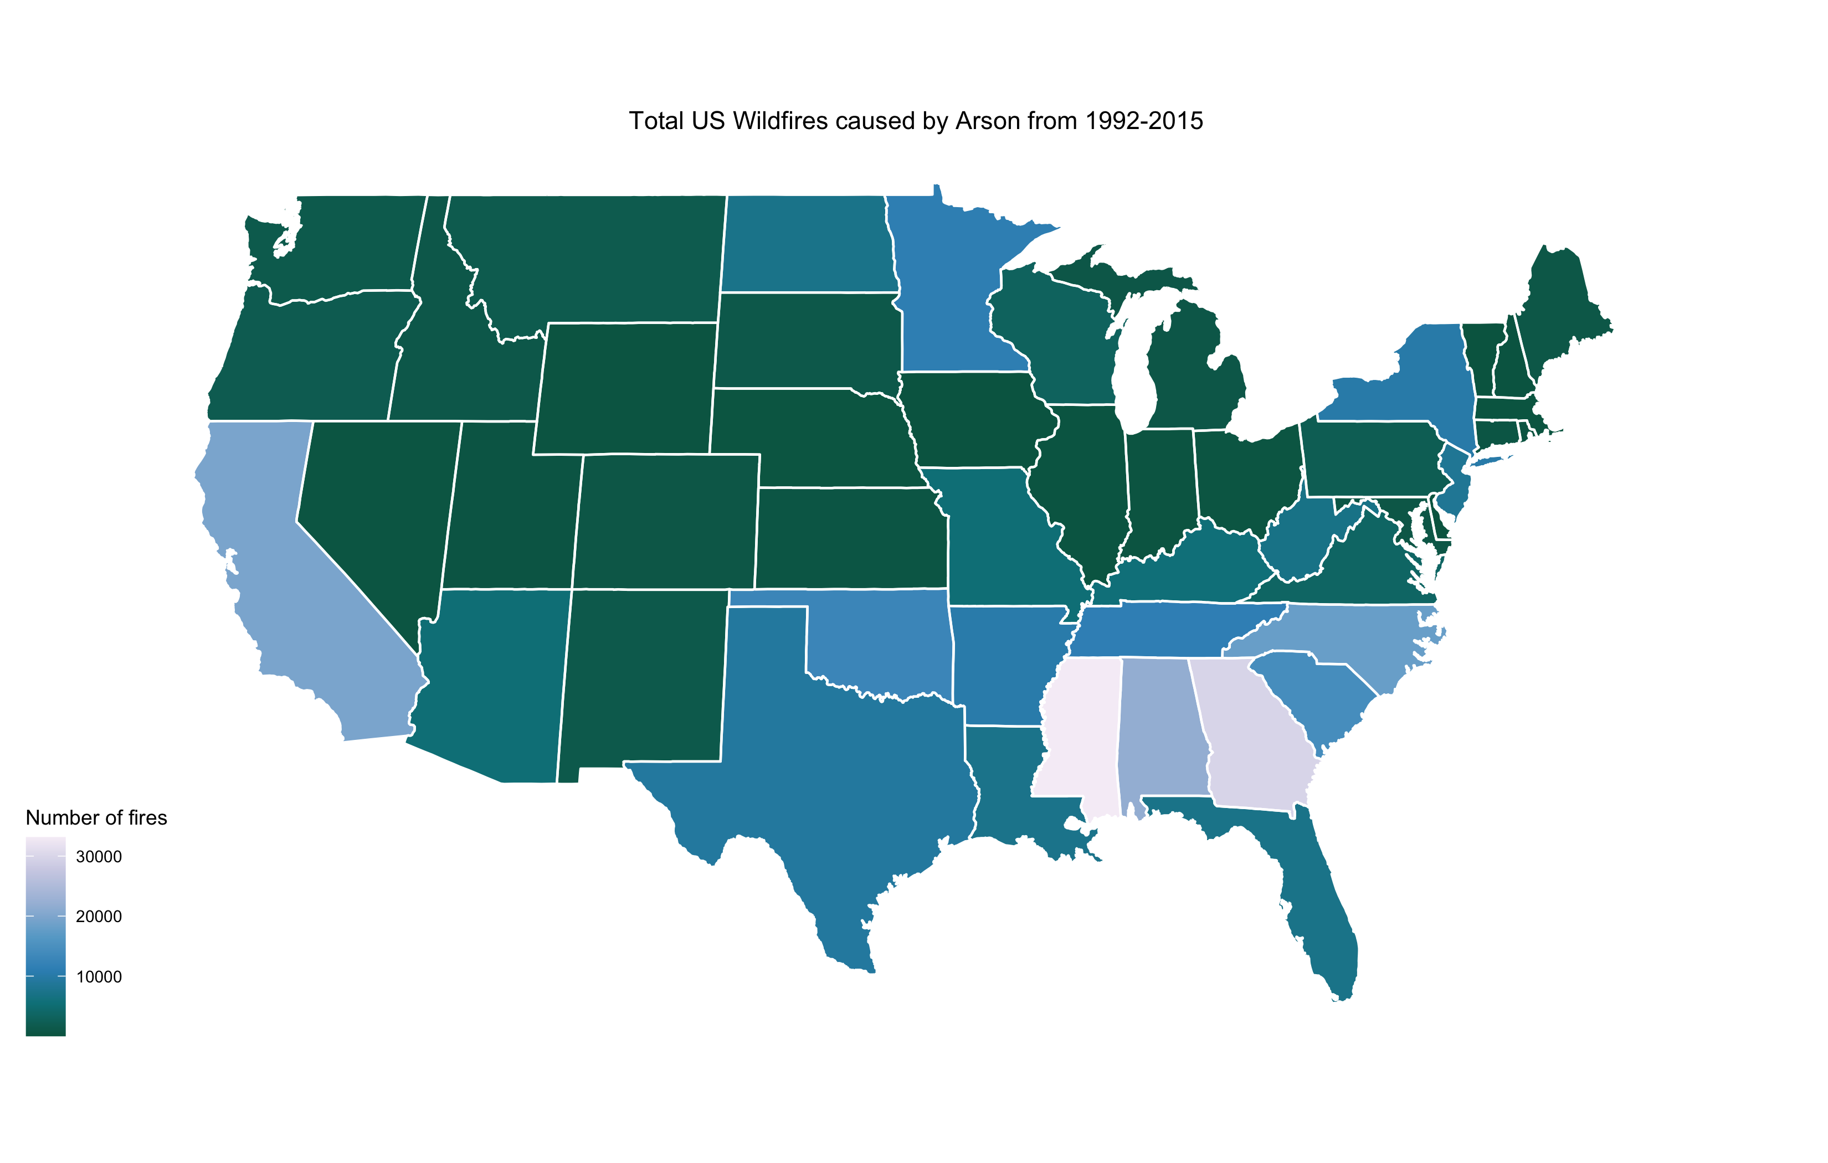
5) Does the cause of fire change between states
There is quite a bit of variation in causation between states
Alabama, Georgia and South Carolina have the most fires due to Arson.

Slide 15
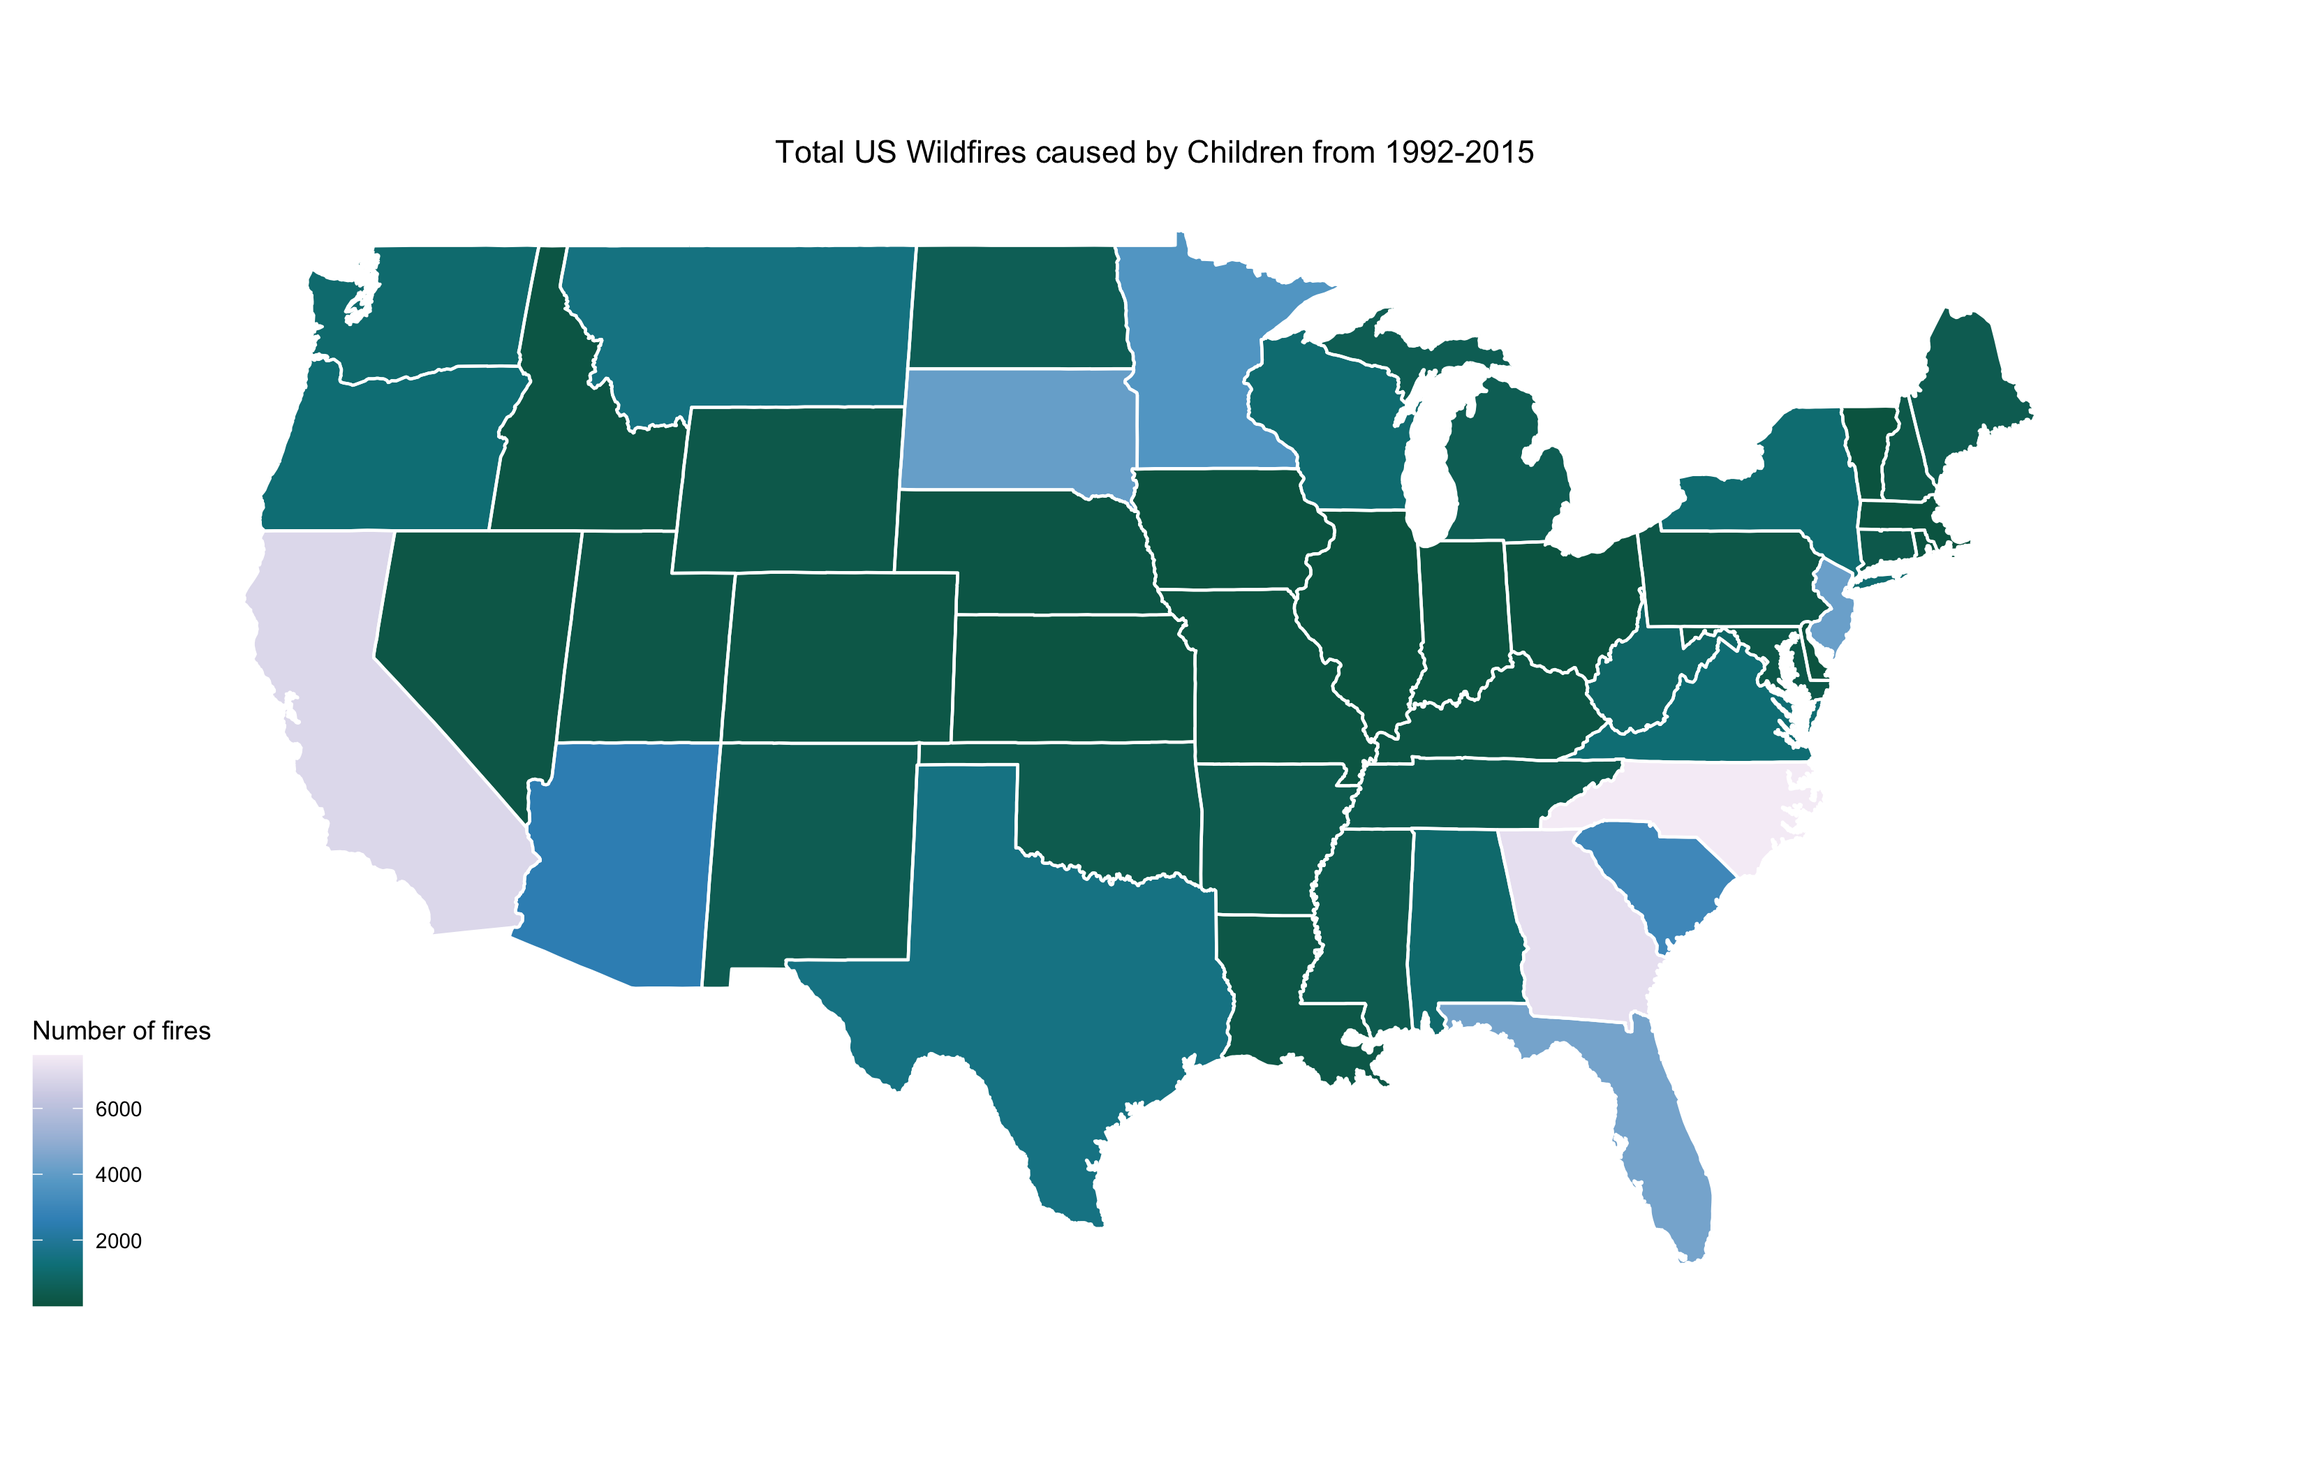
5) Does the cause of fire change between states
The South Eastern states of Georgia and North Carolina also seem to have a reasonably large proportion of fires caused by children, as does California.

Slide 16
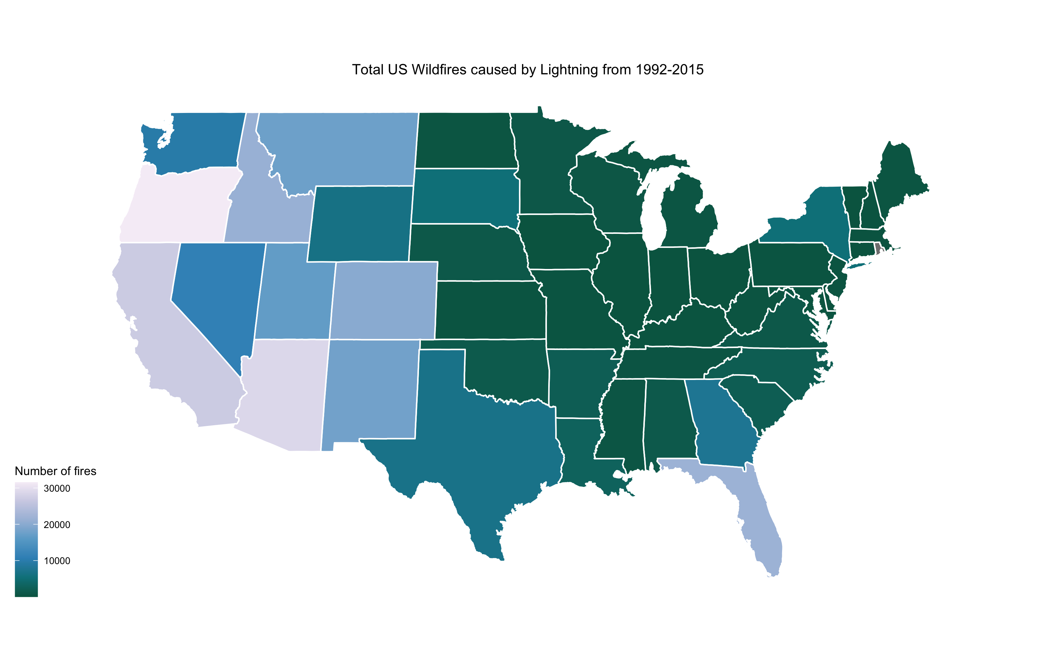
5) Does the cause of fire change between states
Fires by lightning are definitely more common on the West coast of America
Florida is also prone to lightning in the summer months due to tropical storms that are often present near the Caribbean.

Slide 17
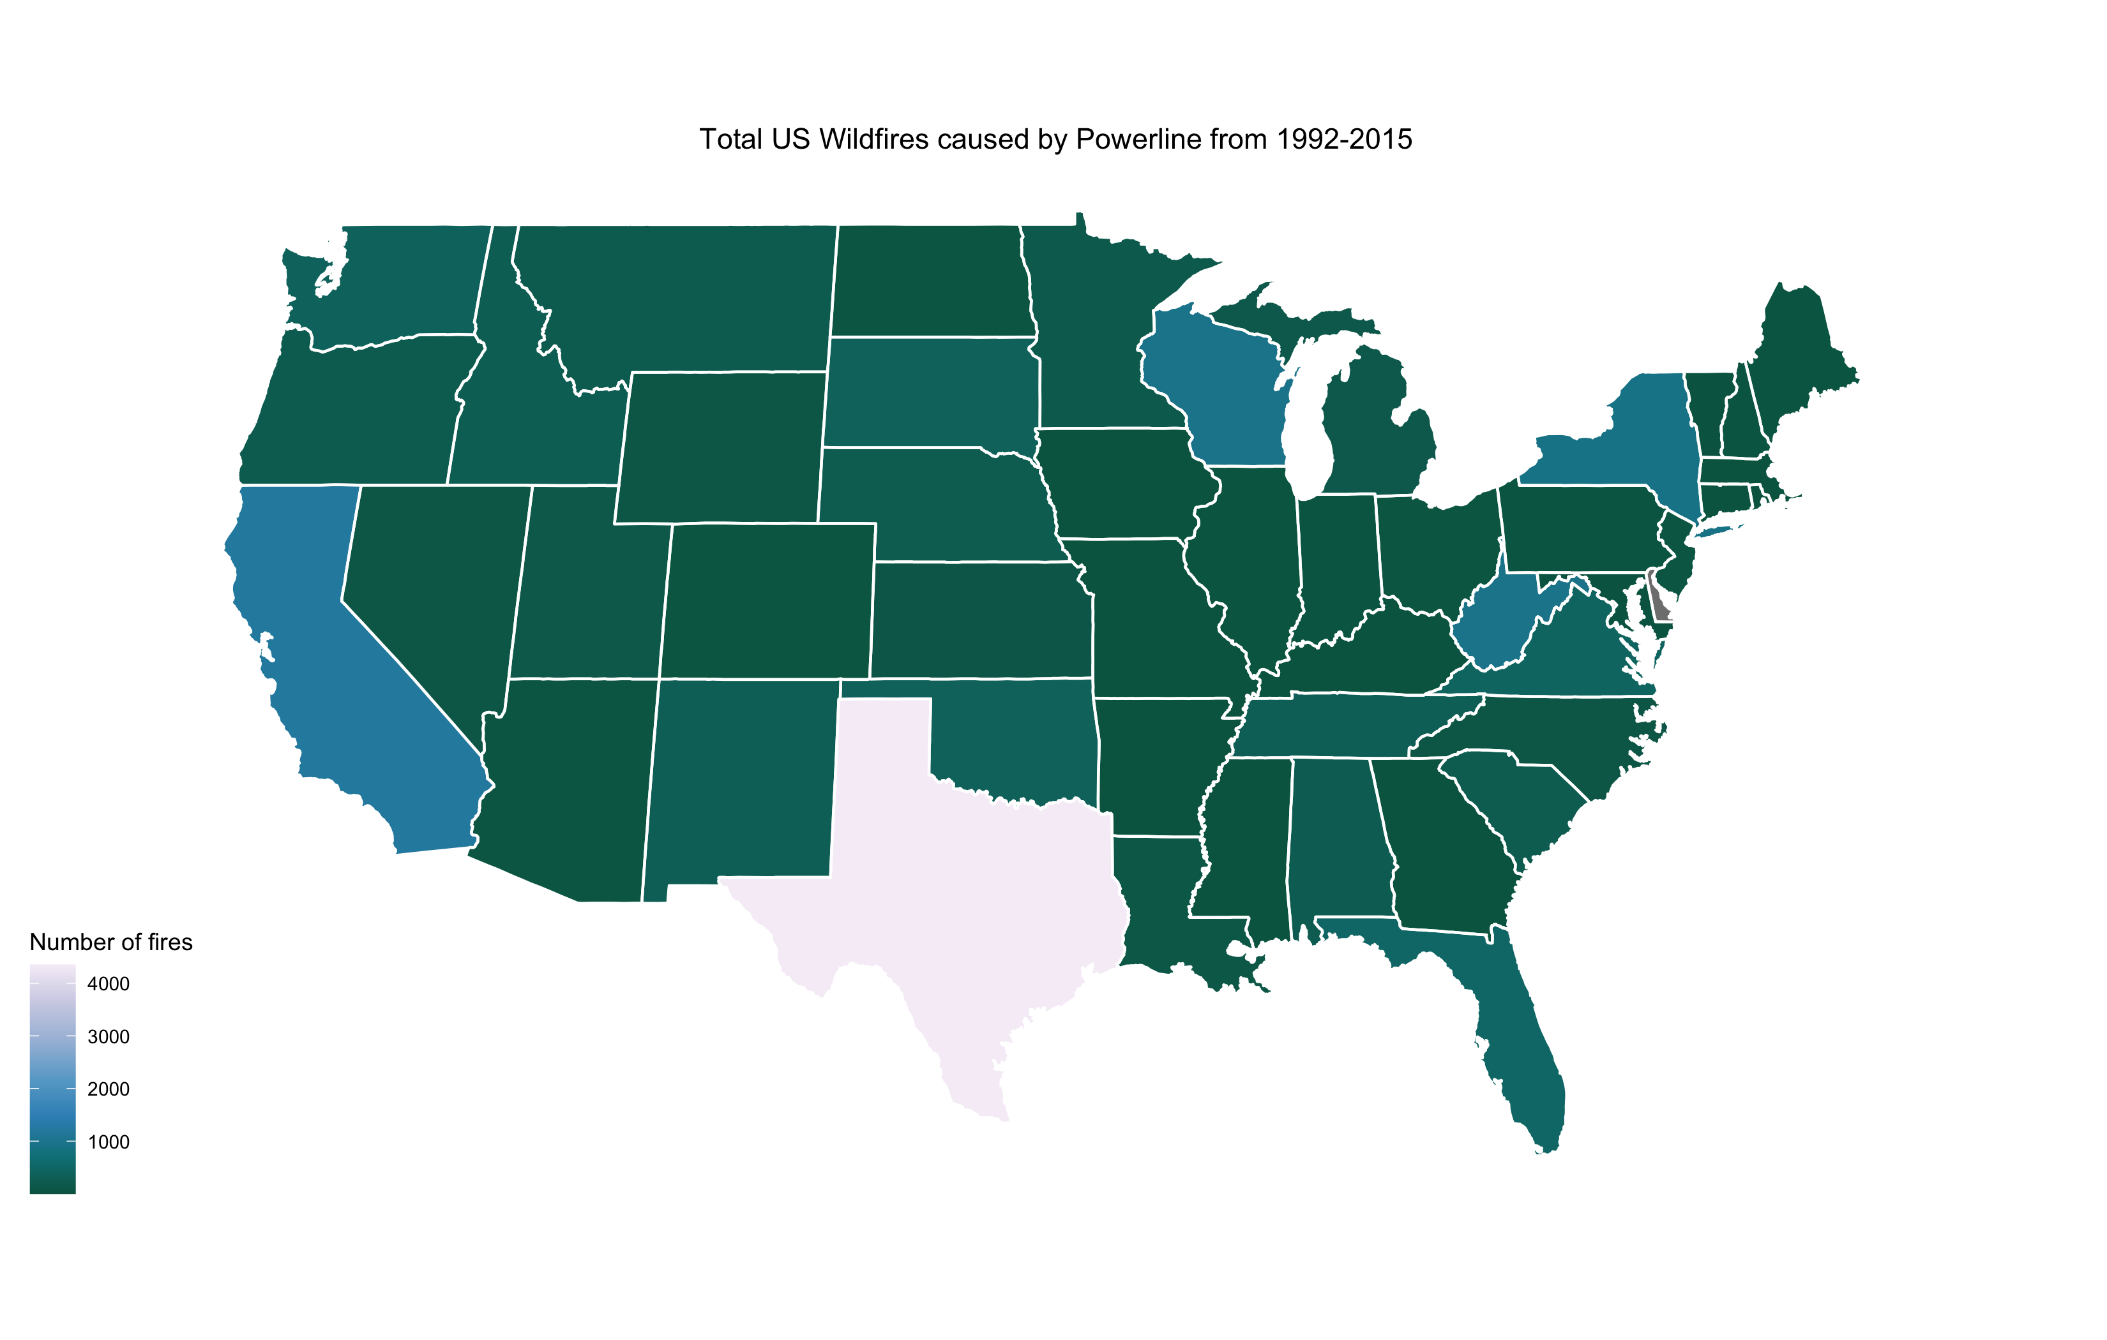
5) Does the cause of fire change between states
Texas has a large proportion of fires due to powerlines compared to the rest of the States
This may be in part to do with the vast areas of open grasslands used for agriculture and cattle. Which due to the climate in the summer months becomes extremely dry and a source of fuel. ⁽²⁾
⁽²⁾ https://uk.reuters.com/article/us-wildfires-texas/trees-and-power-lines-caused-major-texas-fire-idUSTRE78J76A20110920

Slide 18
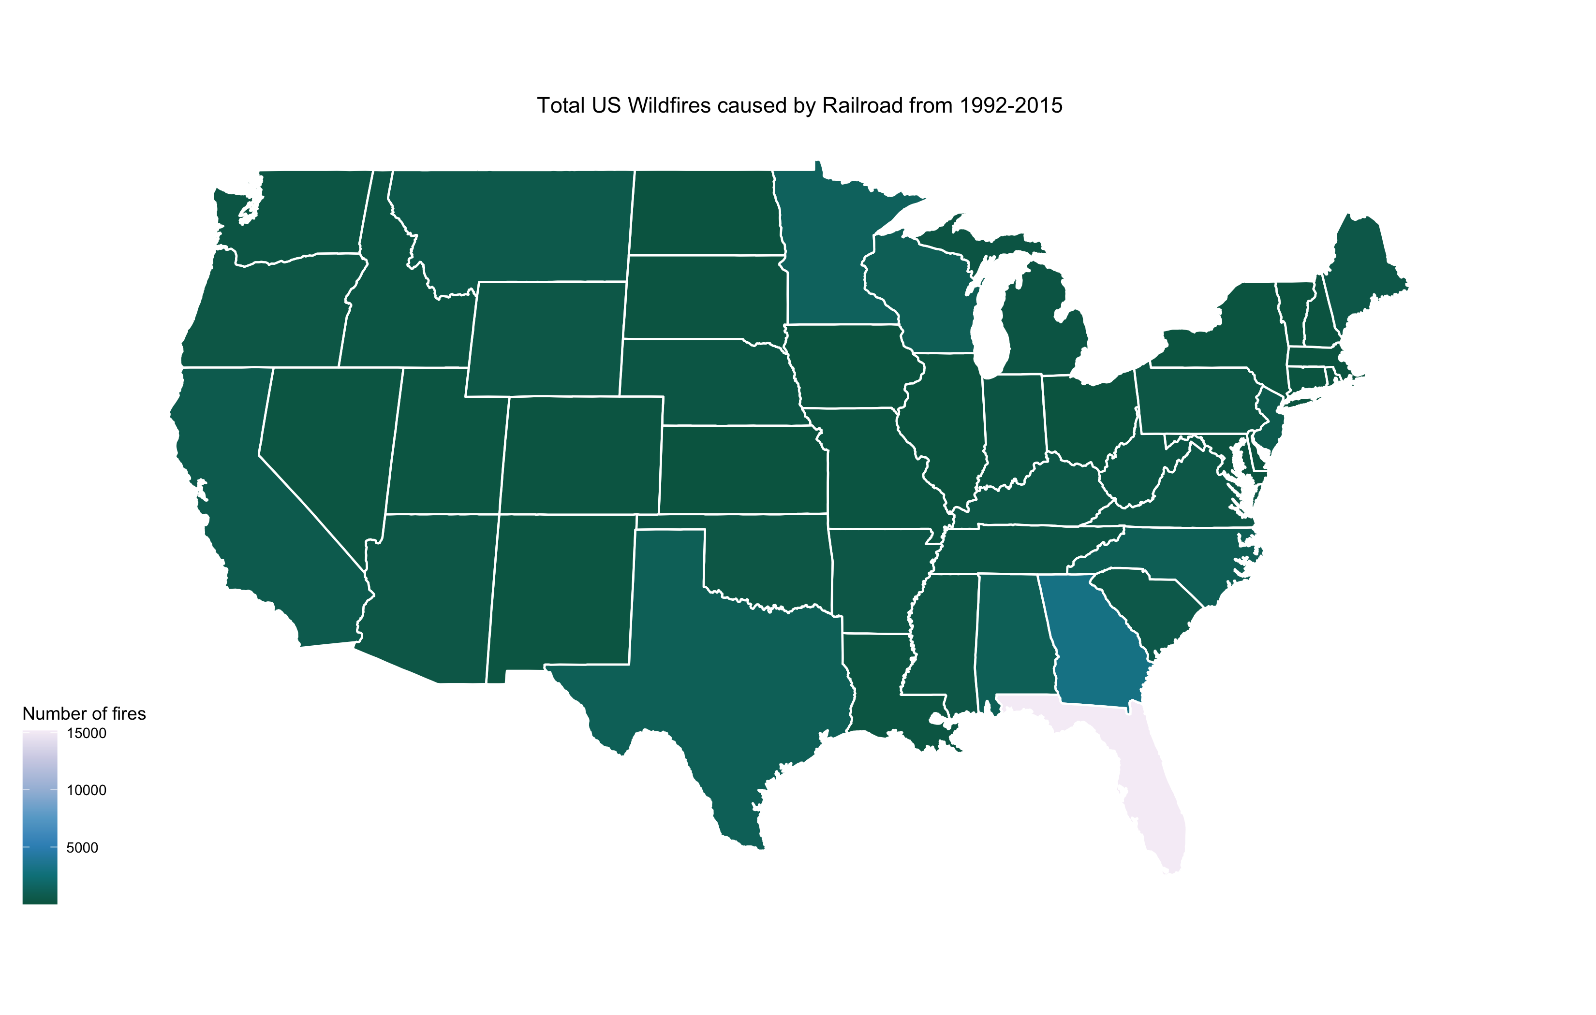
5) Does the cause of fire change between states
Interestingly there is large proportion of fires in Florida that are caused by Railroads, which is strange considering nearly all trains are now electric or diesel
This warrants some more investigation.

Slide 19
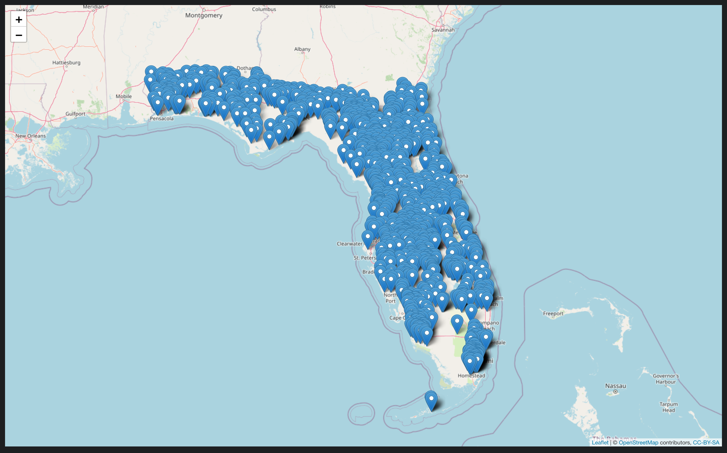
5) Does the cause of fire change between states
This is all of the railroad fires in Florida in 1992 from given lat/long coordinates.
There are far more fires that I would have expected
Several fires are in places where there are no railroads nearby, like Key West at the bottom of the map.

Slide 20
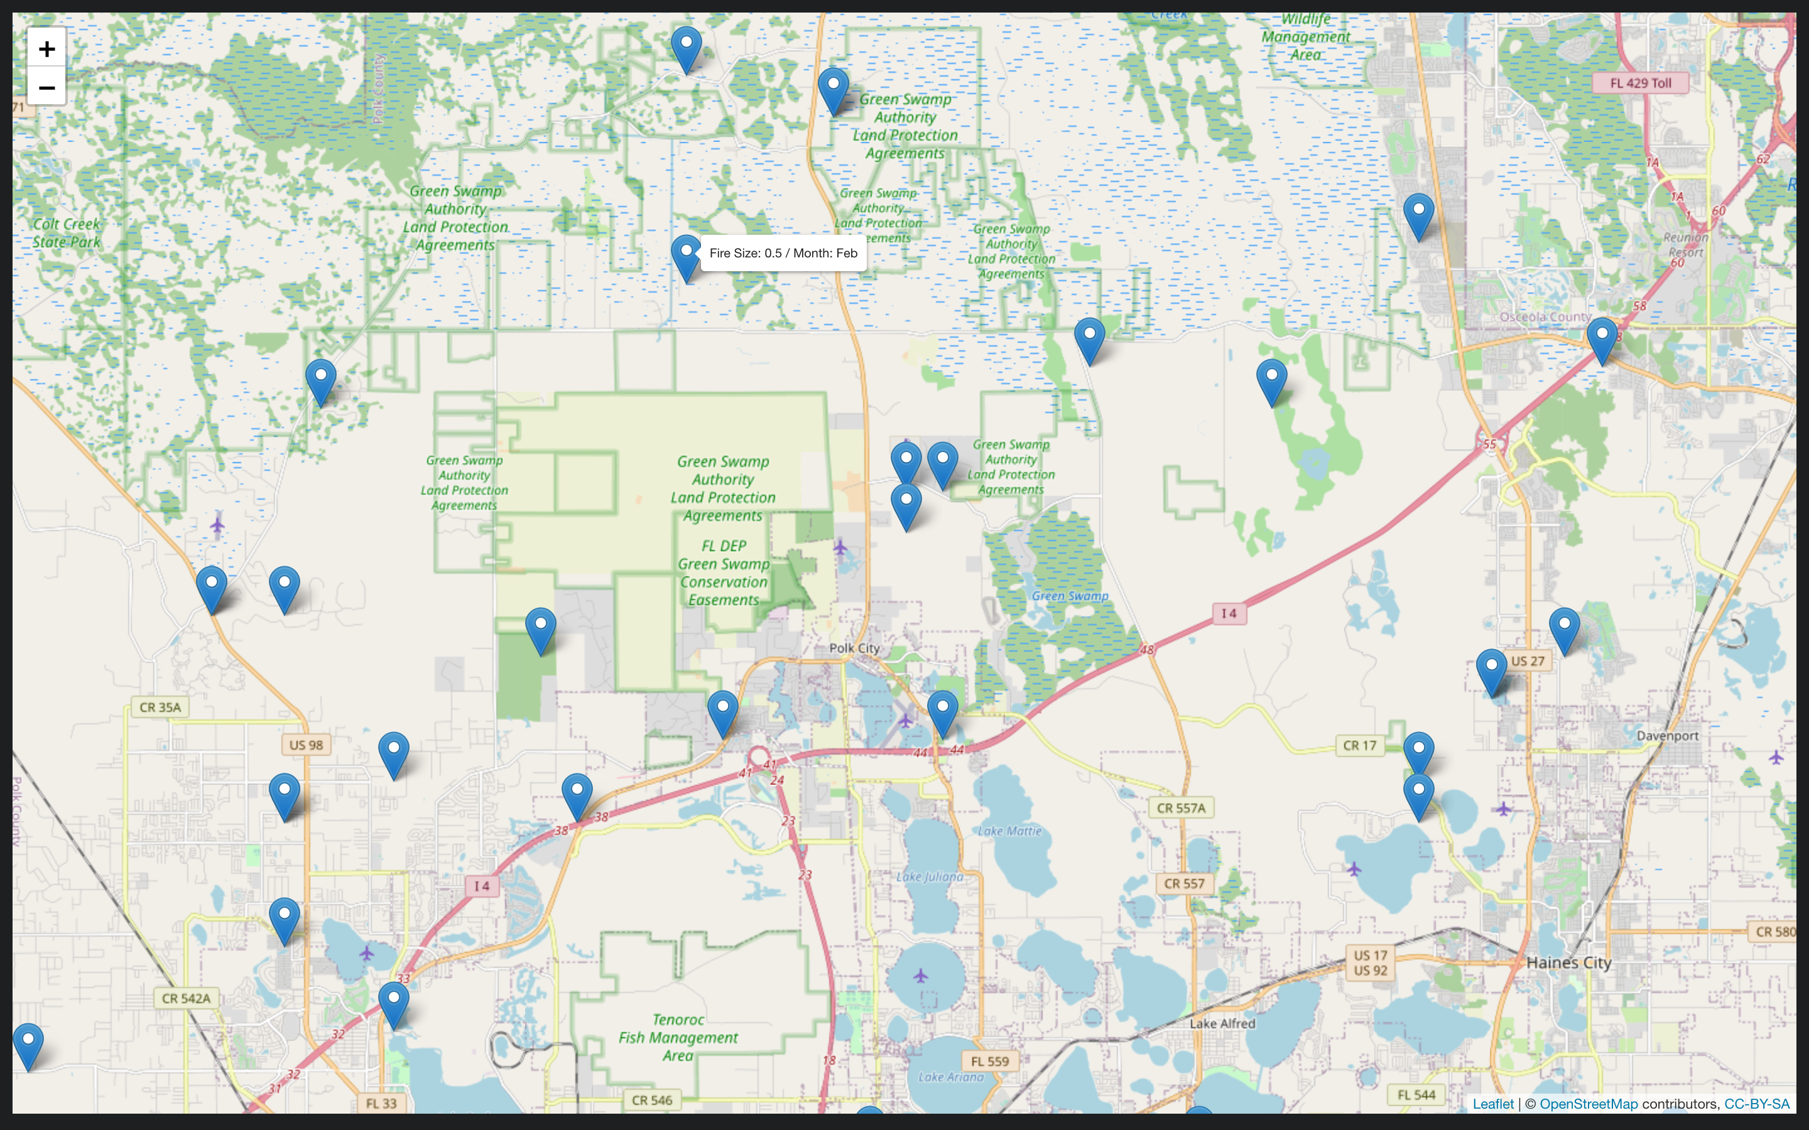
5) Does the cause of fire change between states
As you can see here the railroad is in the far right side of the map going through the town of Maines City.
Yet the origin of fires attributable to railroads are shown a long distance from the tracks, including in swamp land.

Slide 21
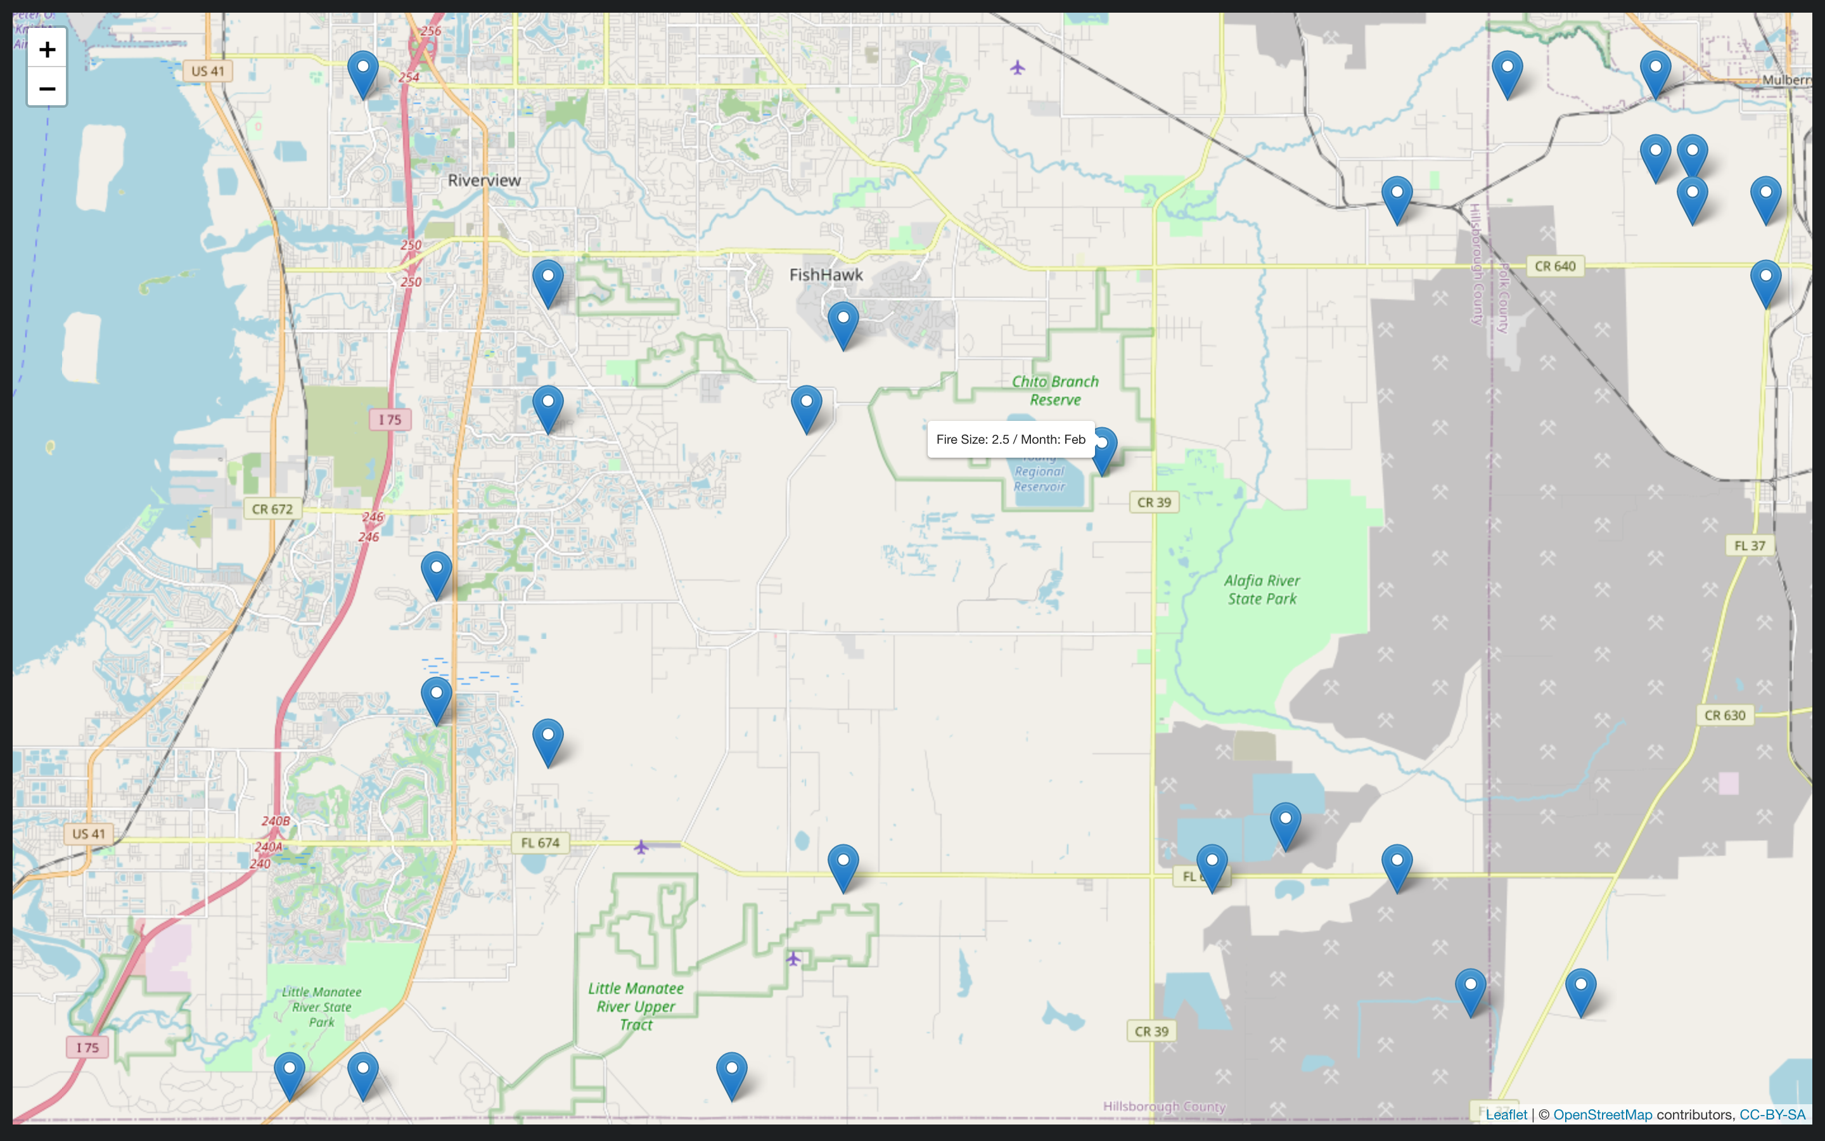
5) Does the cause of fire change between states
I randomly took another year of 1998 and plotted the coordinates in the same way
The same issue can be seen where fires from railroads are being shown starting miles away from any tracks.

Slide 22
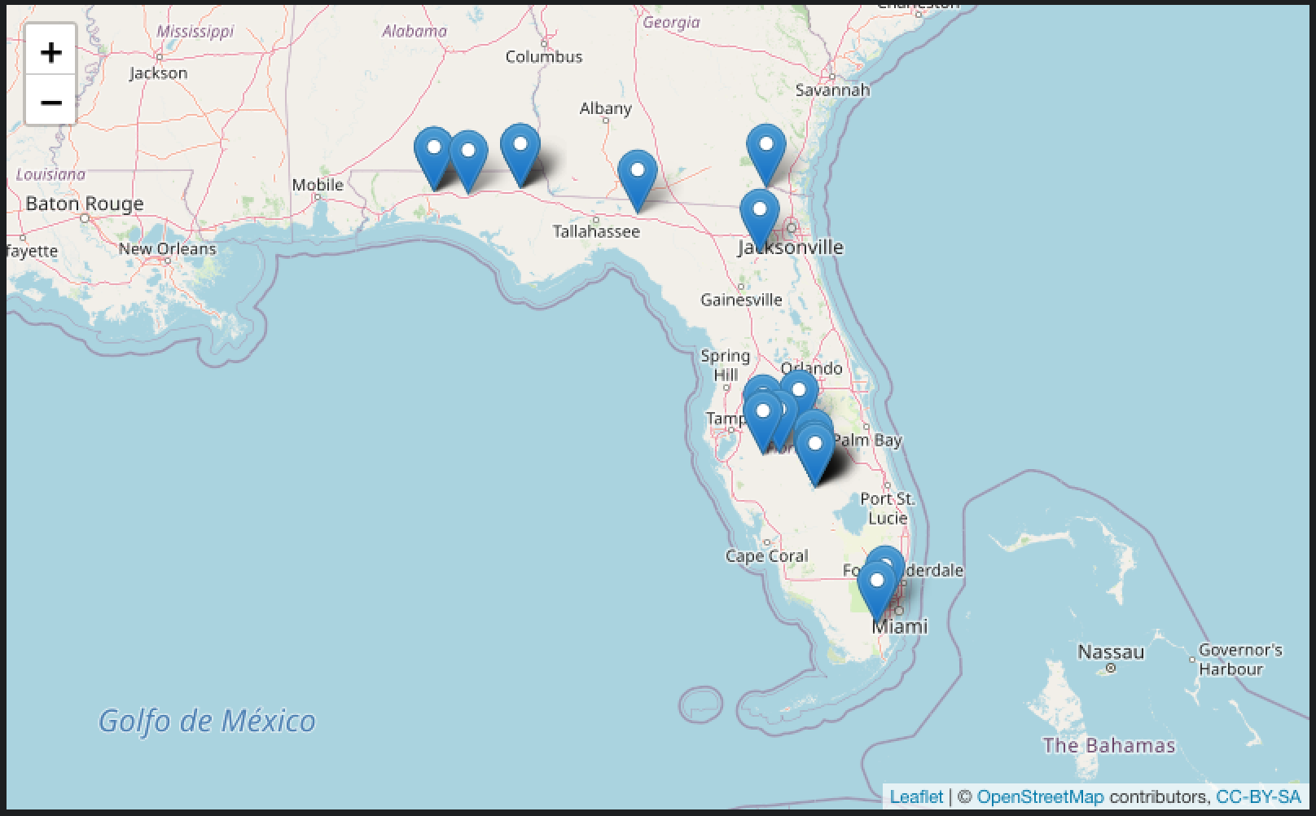
5) Does the cause of fire change between states
Picking another 2 random years of 2008 and 2015, both of these showed totally different results of very few railroad fires present
The location of the fires was also sensible with all of them occurring next to railroads.

Slide 23
5) Does the cause of fire change between states
I am lead to believe that there is a problem with records in the 1990s in Florida
I believe that there has been an error with the classification of origin of a large proportion of fires, probably at the data entry stage
Therefore any further analysis using data from the State of Florida should be carefully examined before any conclusions are made.

Slide 24
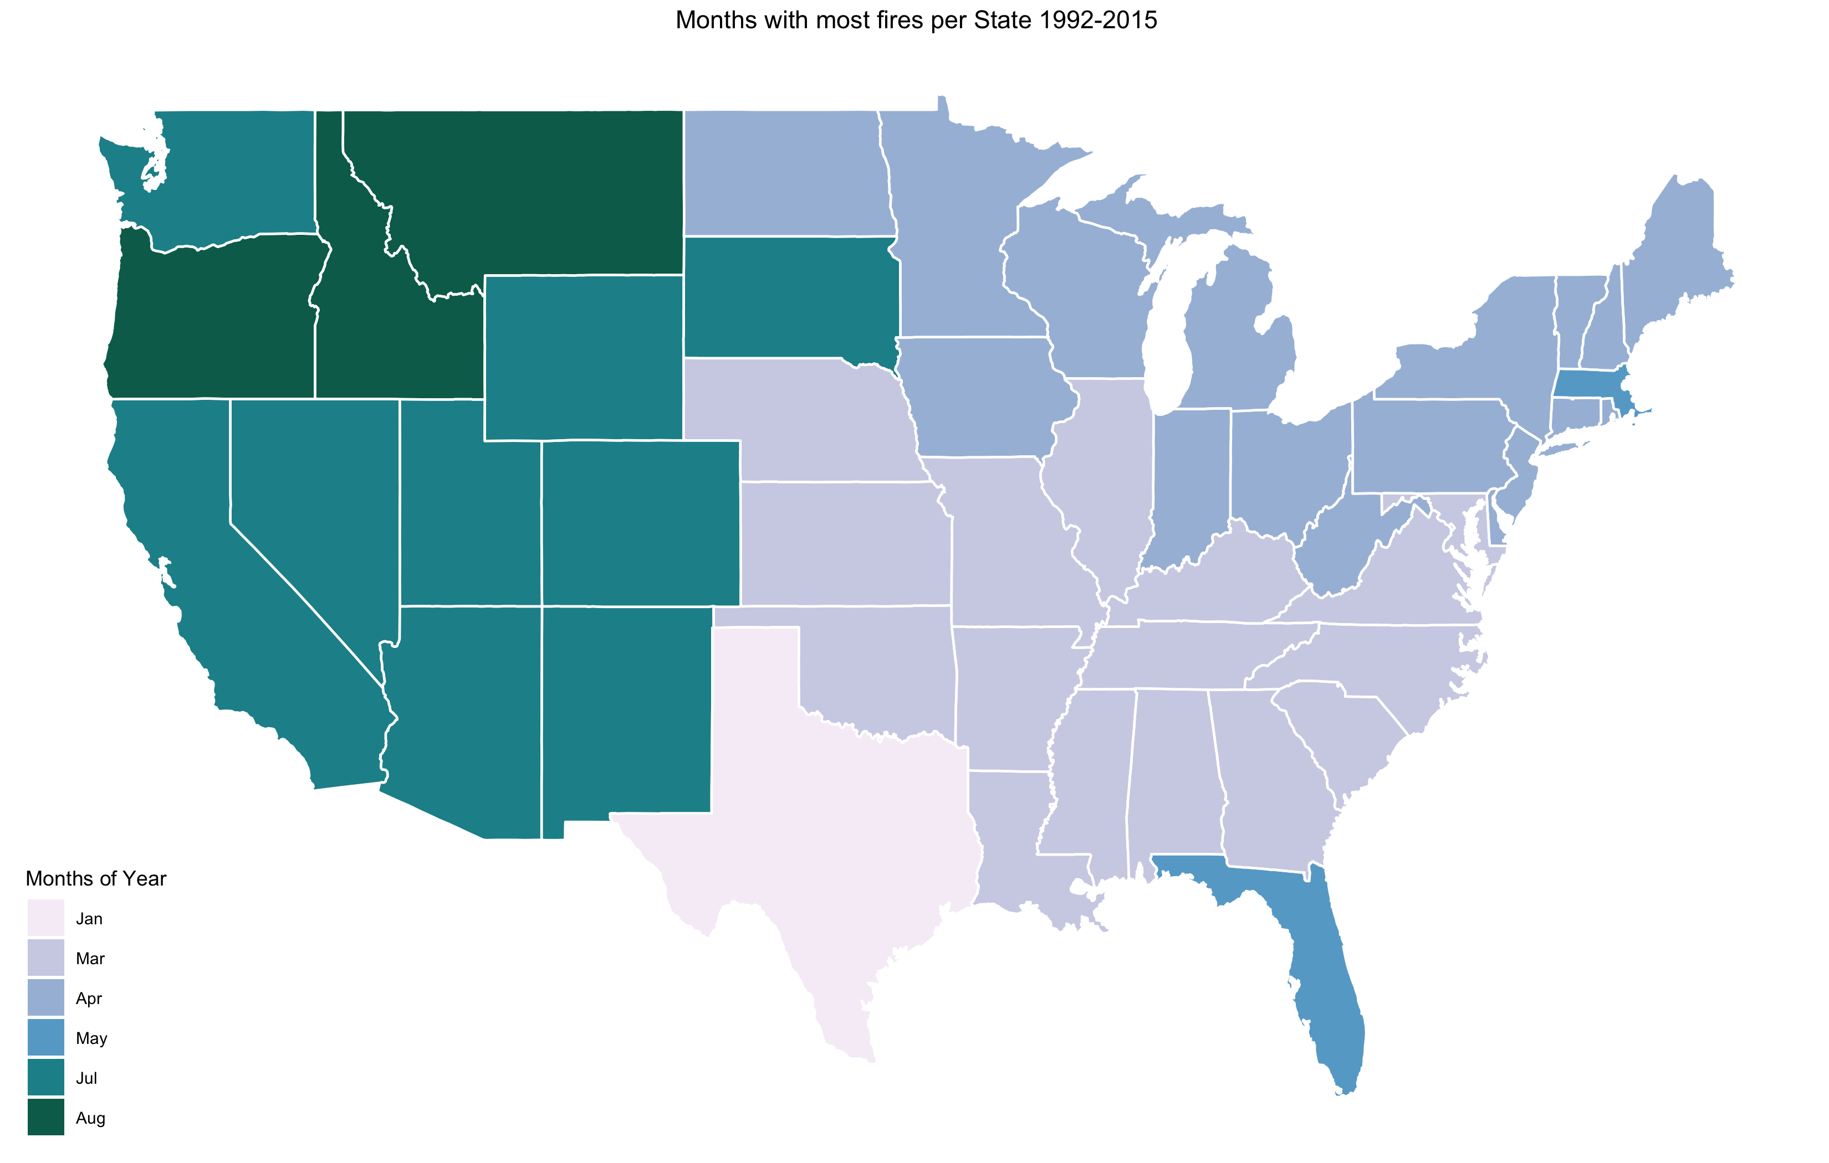
6) Do the most fires occur at the same time of year country wide
As can be seen from the plot, there is a clear East/West split roughly though the middle of the country
The east side of the US seems to have the most fires in the January – May
The west side of the US has the most fires slightly later in May – August
Florida is the exception due to the storms and lightning it experiences in June and July.

